Slide 1
End-to-end Vision-based Autonomous Driving using Deep Learning
Author
Sergio Paniego Blanco
Supervisor
José María Cañas Plaza
Doctoral Program in Information and Communications Technologies
International Doctoral School
2024
@sergiopaniego
sergio.paniego@urjc.es
https://sergiopaniego.github.io/

Slide 2
Outline
Introduction
State-of-the-art
TrafficSensor
DetectionMetrics
Behavior Metrics
Adding memory
Optimizing DL models
Driving in traffic
Conclusions and future research

Slide 3
Outline
Introduction
State-of-the-art
TrafficSensor
DetectionMetrics
Behavior Metrics
Adding memory
Optimizing DL models
Driving in traffic
Conclusions and future research

Slide 4
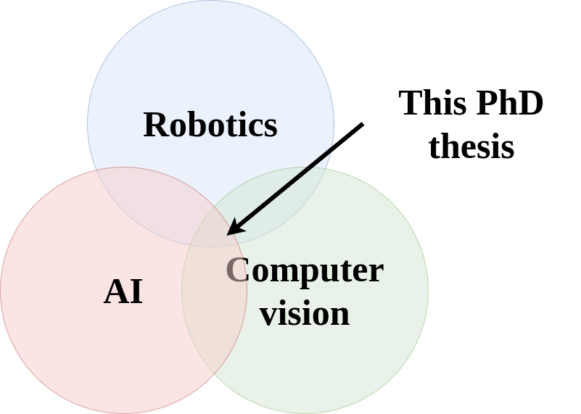
Introduction
Autonomous driving (AD): vehicles that drive safely without human intervention.
Robotics + Artificial Intelligence (AI) + Computer Vision (CV).
Applied to AD.
Development comes from different sides, specially AI.
Benefits and motivation:
Improved traffic safety (94% of accidents caused by human driver error).
Optimized mobility.
Reduce driver’s stress.
Reduce operative costs.
Reduce pollution.
…
Examples of AD companies suggest real advancement.

Slide 5
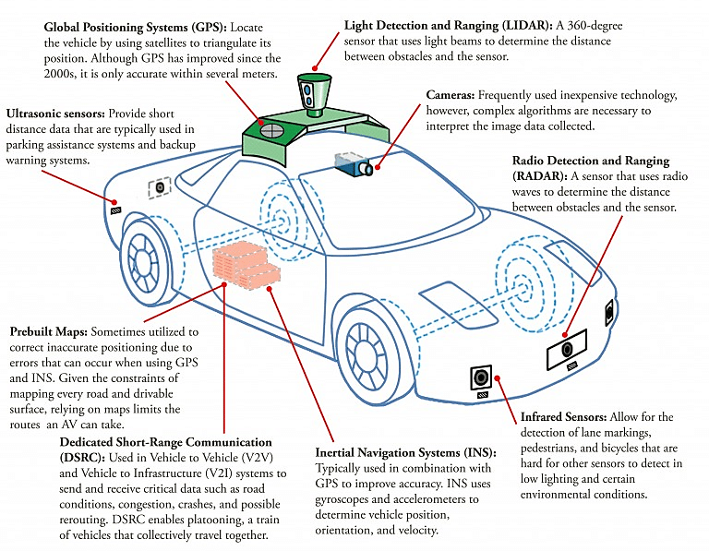
Introduction to AD
Mobile robot in terms of hardware and software.
Sensors like GPS, IMUs, LIDARS, cameras…
Actuators like throttle, brake, steering…
CPUs and GPUs.

Slide 6
Levels of autonomy

Slide 7
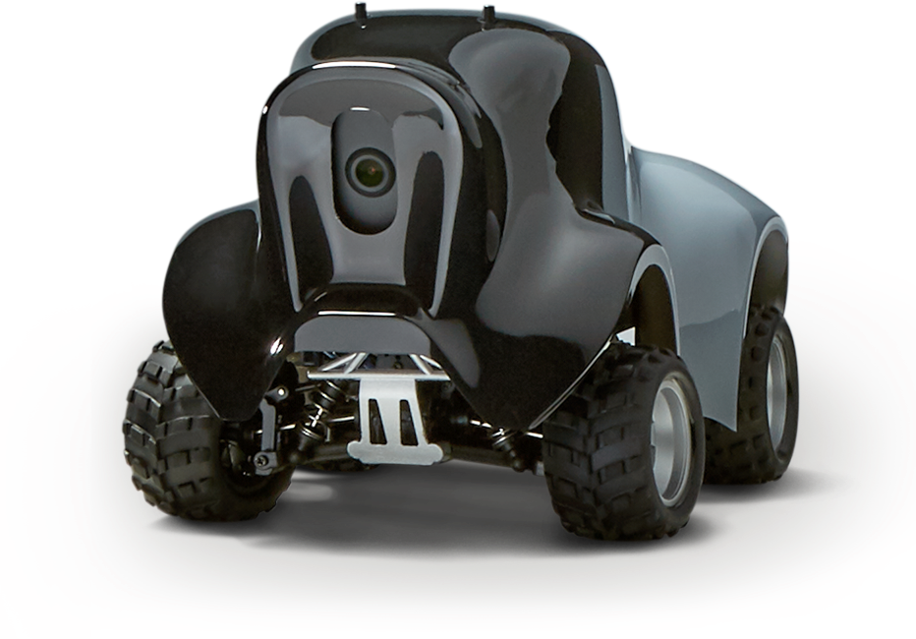
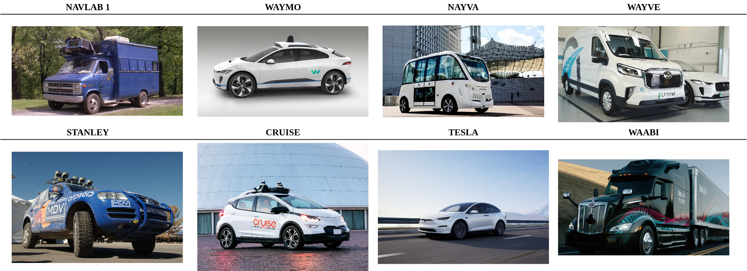
History and present
First examples in the 80s: Navlab 1 (1986), ALVINN (1989)…
DARPA Grand Challenge (2004) and Urban Challenge (2007).
Advanced driver-assistance systems (ADAS).

Slide 8
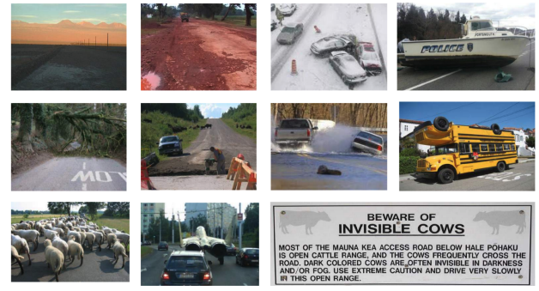
Range of application
Diverse range of environments and weather conditions.
Urban scenarios, roads, highways.
Use of maps.
Vast range of vehicle types.
Robustness is key (high-speed motion and passengers).

Slide 9
Assessment and metrics
AD includes a broad spectrum of methodologies aimed at evaluating solutions derived from research.
Studying the behavior carefully is crucial for understanding both its strengths and weaknesses.
Massive datasets and simulators.
Automatic and massive testing.
Offline vs online.

Slide 10
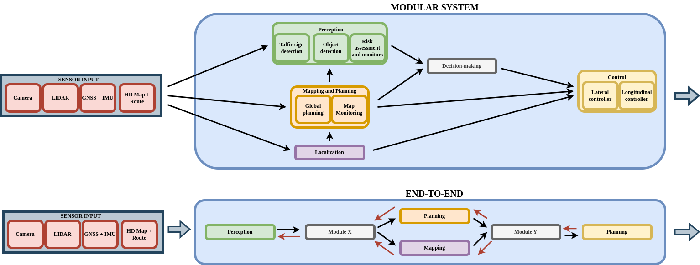
End-to-end and modular approaches
2 main approaches in the development of AD solutions:
Modular.
End-to-end (E2E).
The majority are currently modular but there is a trend towards end-to-end.

Slide 11
Research goals
Make contributions in the field of vision-based autonomous driving using deep learning, imitation learning and end-to-end models.
Deep learning-based visual traffic monitoring tool.
Generate software for validating object detection solutions.
Create software to assess autonomous driving behaviors and generate quantitative data.
Study of enhancements to visual lane following using visual memory and kinematic input.
Optimizing AD vehicle controllers to enhance performance.
Create and E2E shallow model for driving in traffic using vision.

Slide 12
Outline
Introduction
State-of-the-art
TrafficSensor
DetectionMetrics
Behavior Metrics
Adding memory
Optimizing DL models
Driving in traffic
Conclusions and future research

Slide 13
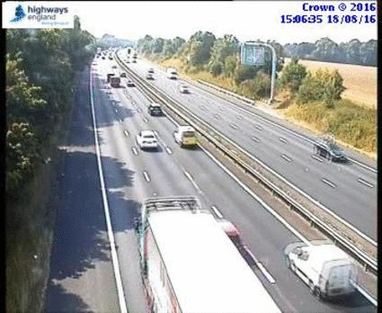
Traffic monitoring
Traffic monitoring is a classic problem within CV.
Traffic surveillance using video cameras was significantly improved with DL.

Slide 14
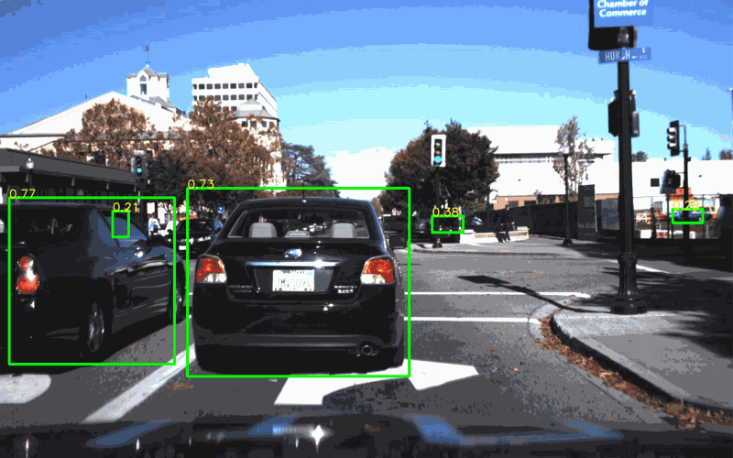
Deep learning object detection, datasets and assessment
Significant popularity lately. Notable advancements.
Part of the perception in autonomous driving systems.
Many datasets are available like COCO, ImageNet, Pascal VOC… and some others specialized.
Each CV tasks includes a specific set of evaluation metrics.
All the current state-of-the art solutions rely on DL.
Faster R-CNN, SSD, YOLO, DETR, Swin Transformer, DINO…

Slide 15
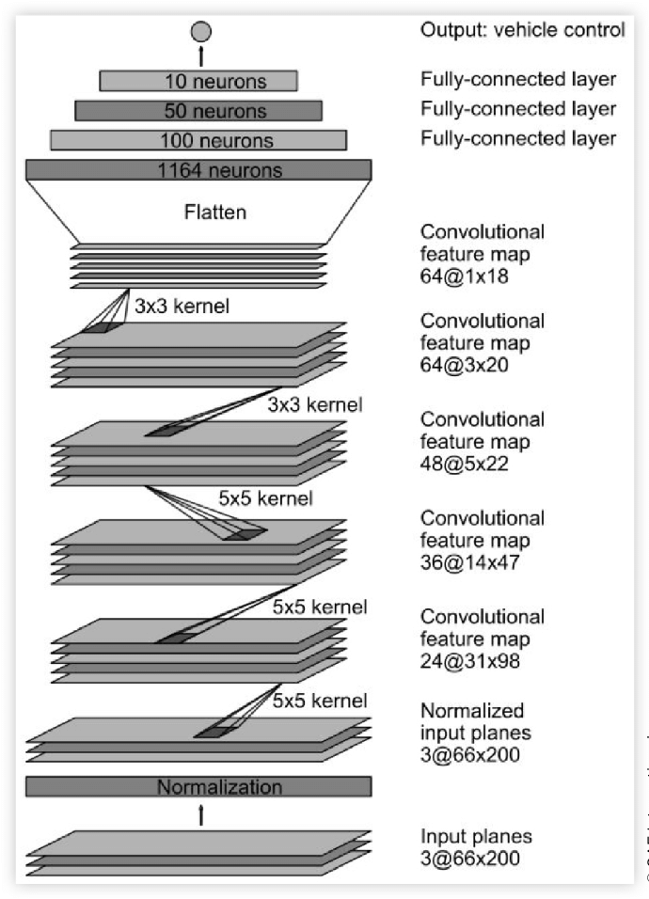
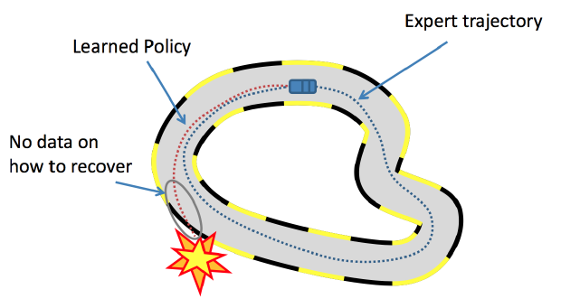
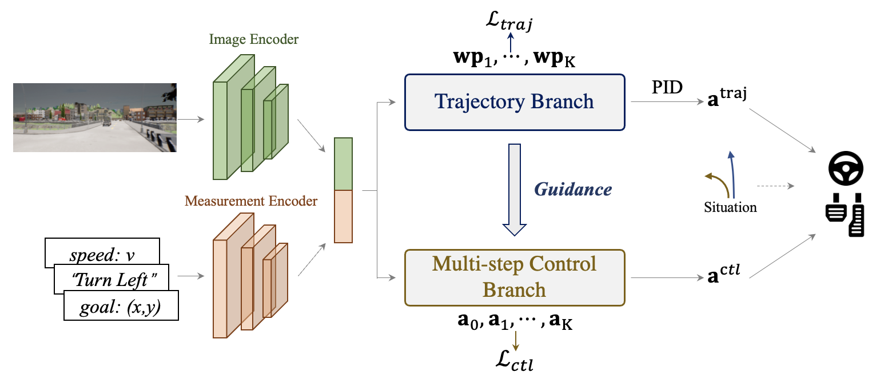
Imitation learning and RL for driving autonomously
Imitation learning (behavior cloning).
Reinforcement learning (RL- DRL).
PilotNet. Vision-based E2E AD.
TCP, ReasonNet, Transfuser…

Slide 16
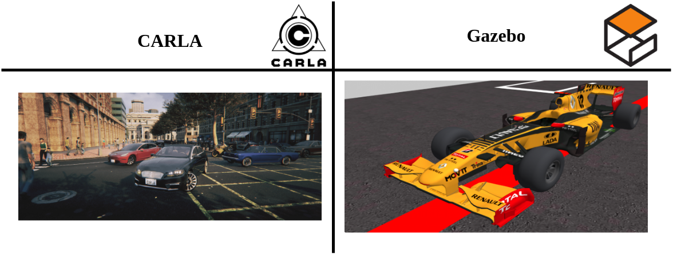
Simulation in AD and assessment. Datasets
Importance of simulation in robotics, in addition to real-world testing.
Diverse simulators for AD are available: SUMO, TORCS, Gazebo, CARLA, DeepDrive, Autoware, proprietary simulators, world generators…

Slide 17
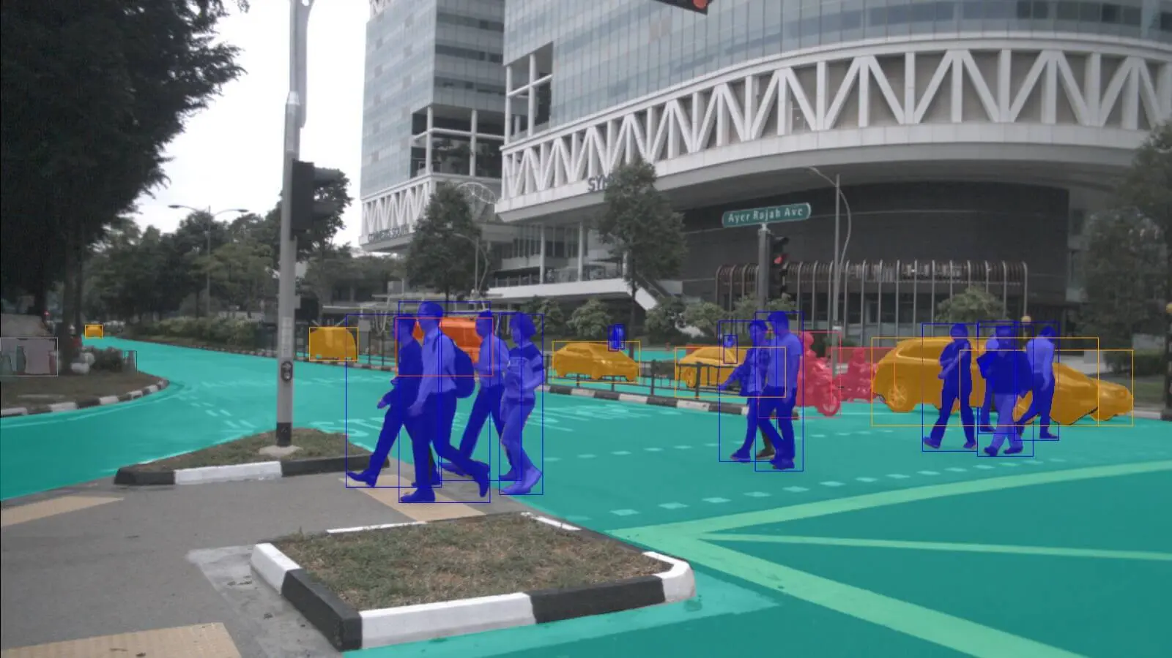
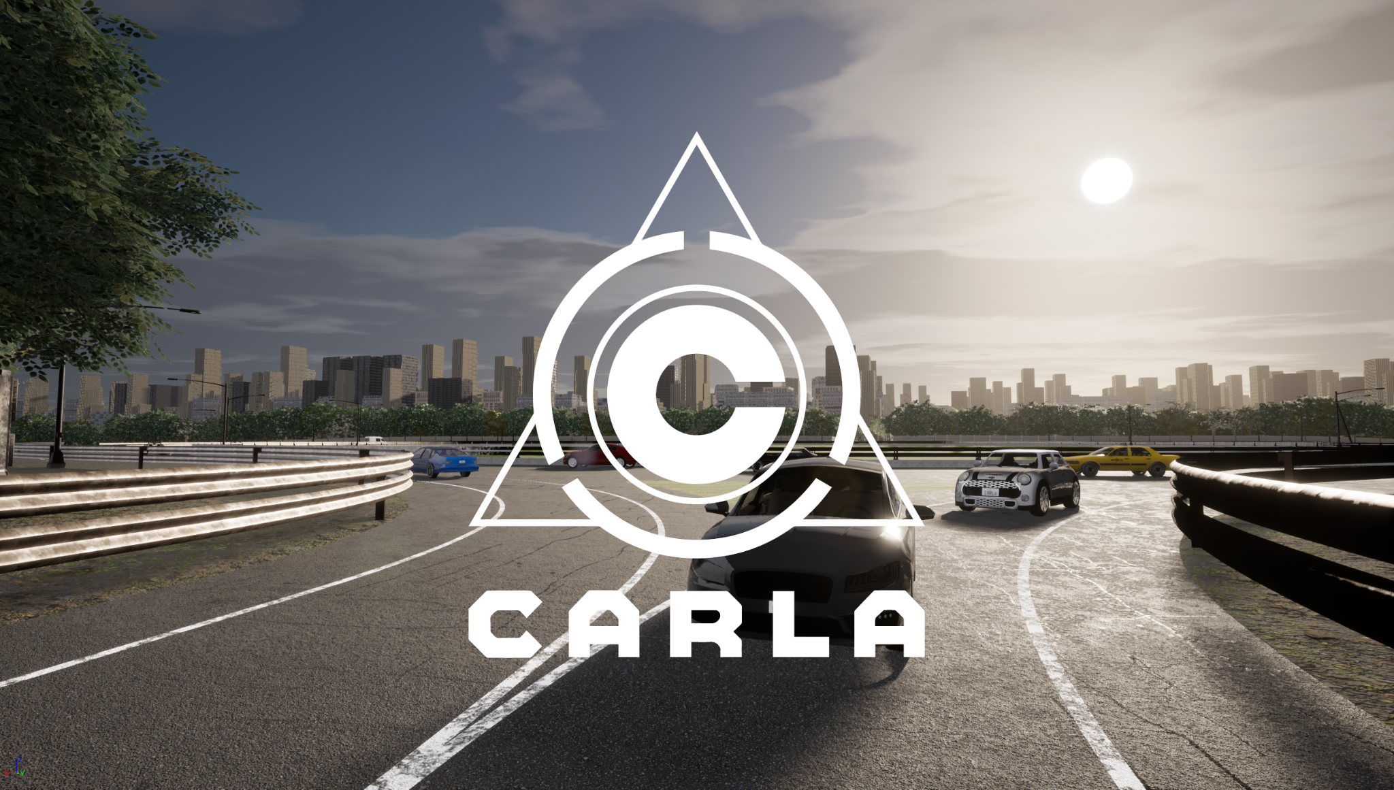
Simulation in AD and assessment. Datasets
In AD development, there are a lot of specialized datasets: nuScenes, BDD100K, KITTI, Cityscapes…
CARLA Leaderboard for the assessment of solutions.
Many different tasks and specific metrics needed.

Slide 18
Outline
Introduction
State-of-the-art
TrafficSensor
DetectionMetrics
Behavior Metrics
Adding memory
Optimizing DL models
Driving in traffic
Conclusions and future research
Perception content block

Slide 19
Monitoring and assessing traffic with deep learning
Monitoring of real-time traffic on highways, road, and streets may provide useful data both for infrastructure planning and for traffic management in general.
TrafficSensor: open-source system that employs deep learning for automatic vehicle tracking and classification on highways using a calibrated and fixed camera.
Evolution of previous system (TrafficMonitor).
Intro to traffic application domain, CV, AD.
J. Fernández, J. M. Cañas, V. Fernández, and S. Paniego, “Robust real-time traffic surveillance with deep learning,” Computational Intelligence and Neuroscience, vol. 2021, p. 4 632 353, Dec. 2021. doi: 10.1155/2021/4632353. [Online]. Available: https://doi.org/10.1155/2021/4632353

Slide 20
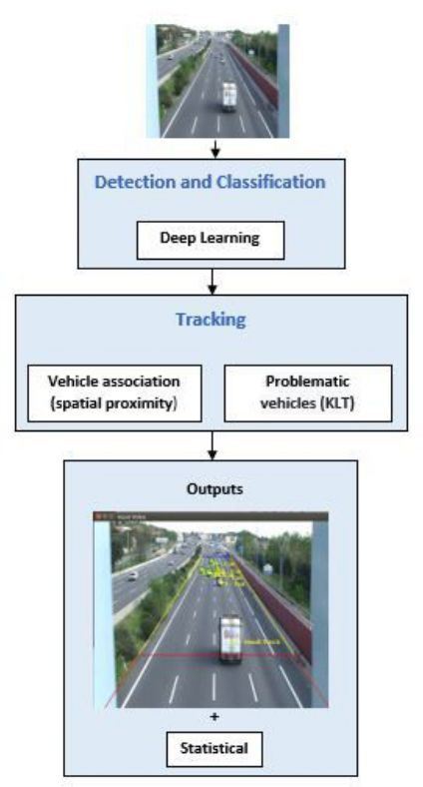
Monitoring and assessing traffic with deep learning
New dataset created (7 vehicle types).
Two modules:
Vehicle detection and classification.
Vehicle tracking.
1st module: YOLOv4.
2nd module: simple spatial association algorithm and more sophisticated KLT tracker to follow the vehicles.
Several experiments validated the system.

Slide 21
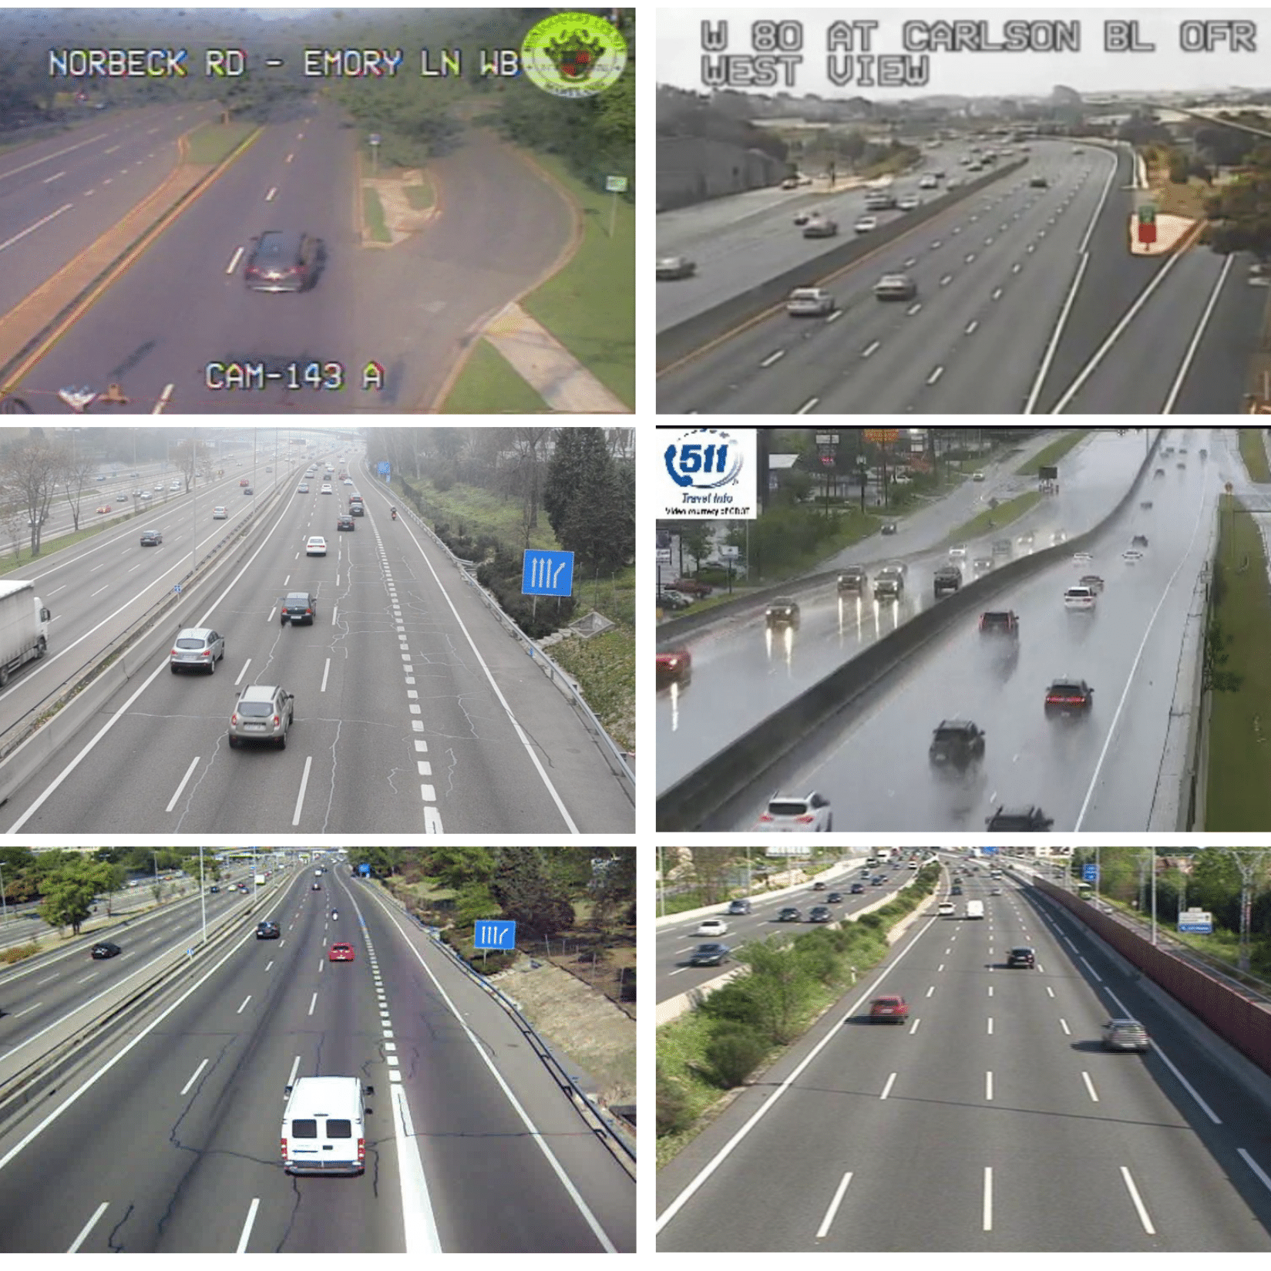
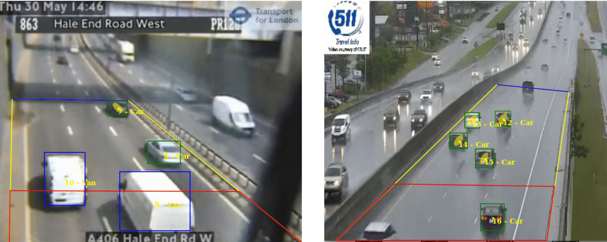
Experimental evaluation
System validated with a dataset of real traffic images.
Detection Metrics for comparing different object detection DL models (my contribution).
Dataset (~10000 examples):
Good weather conditions.
Bad weather conditions.
Poor-quality images.

Slide 22
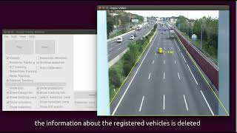
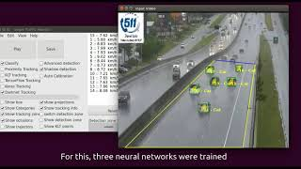
Conclusions
TrafficSensor is a solution for vehicle surveillance using deep learning. 7 classes.
Different DL models were studied and tested.
A new dataset was curated for this application.
The application proves to be robust to bad weather conditions, and blurred or low-resolution traffic images.
State-of-the-art enhancements.

Slide 23
Outline
Introduction
State-of-the-art
TrafficSensor
DetectionMetrics
Behavior Metrics
Adding memory
Optimizing DL models
Driving in traffic
Conclusions and future research

Slide 24
Assessing object detection deep learning architectures with quantitative metrics
Detection Metrics.
Comparison tool for the objective assessment of object detection approaches.
Open-source.
S. Paniego, V. Sharma, and J. M. Cañas, “Open source assessment of deep learning visual object detection,” Sensors, vol. 22, no. 12, 2022. doi: 10.3390/s22124575. [Online]. Available: https://www.mdpi.com/1424-8220/22/12/4575

Slide 25
Introduction
Objective performance metrics.
Systematic evaluation of different DL models for object detection on large datasets.
Broad range of applicability: traffic monitoring, autonomous driving perception…
Suite of tools with unique features to facilitate the objective comparison of different DL models for object detection.

Slide 26
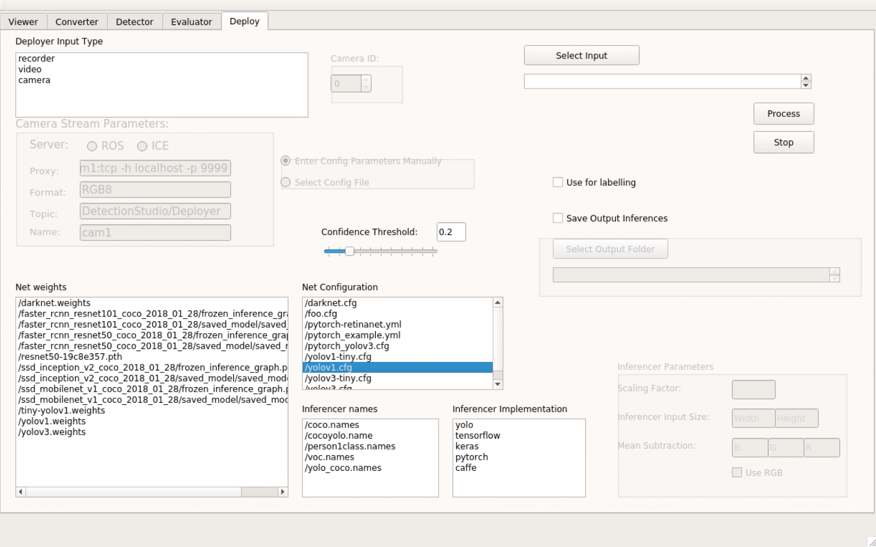
Detection Metrics tool kit
DL frameworks support.
Object detection datasets support.
It can be used as a ROS Node.
Two workflows:
Headless.
Graphical.
Main tools:
Detection generation.
Evaluation of detections with objective metrics.
Live detection visualization.
Dataset converter.

Slide 27
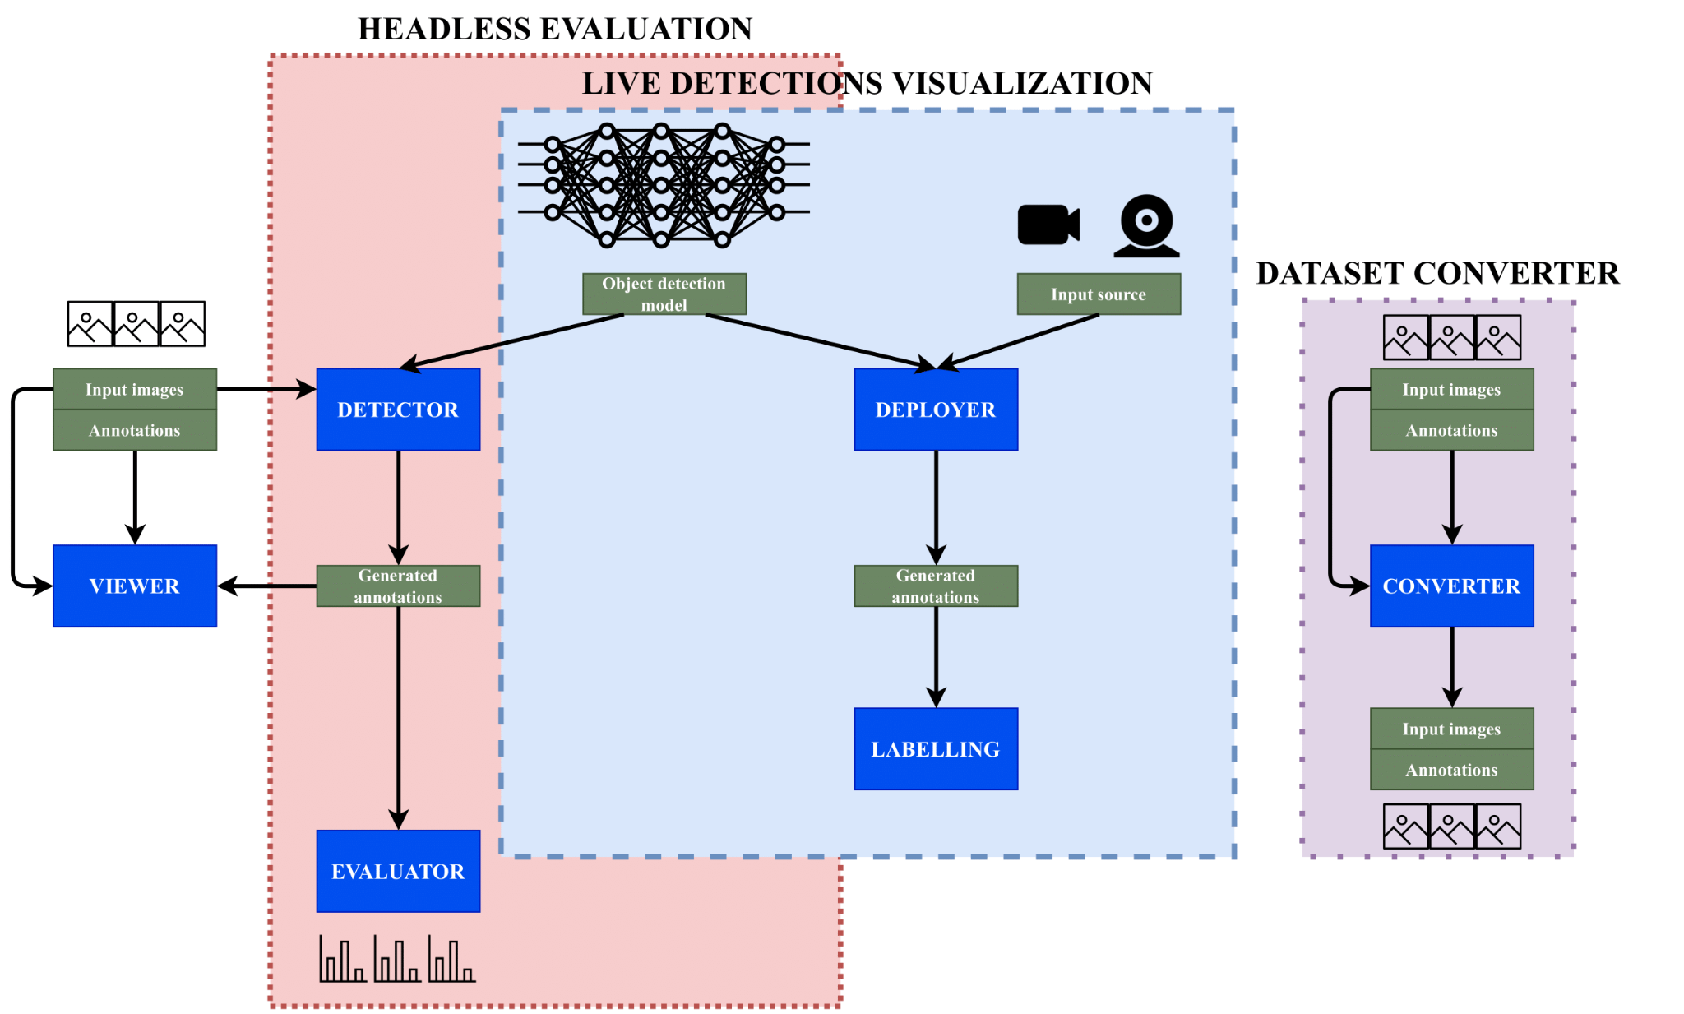
Detection Metrics tool kit

Slide 28
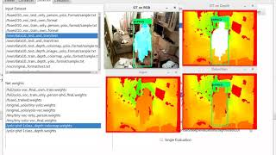
Detection Metrics tool kit

Slide 29
Experimental results and discussion
Used in TrafficSensor validation.
Comparison of state-of-the-art detection networks.

Slide 30
Conclusions
DetectionMetrics: open source assessment tool for developing object detection solutions validated in several experiments.
State-of-the-art enhancements.

Slide 31
Outline
Introduction
State-of-the-art
TrafficSensor
DetectionMetrics
Behavior Metrics
Adding memory
Optimizing DL models
Driving in traffic
Conclusions and future research
Control and decision-making content block

Slide 32
Assessing autonomous driving behaviors fine-grained metrics
Behavior Metrics is an open-source software tool developed to help research in the autonomous driving field.
The development and validation of autonomous driving solutions require testing broadly in simulation (online).
Quantitative and qualitative assessment and comparison of solutions for the main autonomous driving tasks.
S. Paniego, R. Calvo-Palomino, and J. Cañas, "Behavior Metrics: An Open-Source Assessment Tool for Autonomous Driving Tasks," Software X, vol. 26, pp. 101702, 2024 doi: 10.1016/j.softx.2024.101702. [Online]. Available: https://doi.org/10.1016/j.softx.2024.101702

Slide 33
Assessing autonomous driving behaviors fine-grained metrics
Two main evaluation pipelines:
Graphical.
Headless.
Generates quantitative metrics complementary to the simulator’s, including fine-grained metrics for each particular driving task (lane following, driving in traffic, route navigation…).
It uses and supports Carla, ROS, PyTorch and Tensorflow.

Slide 34
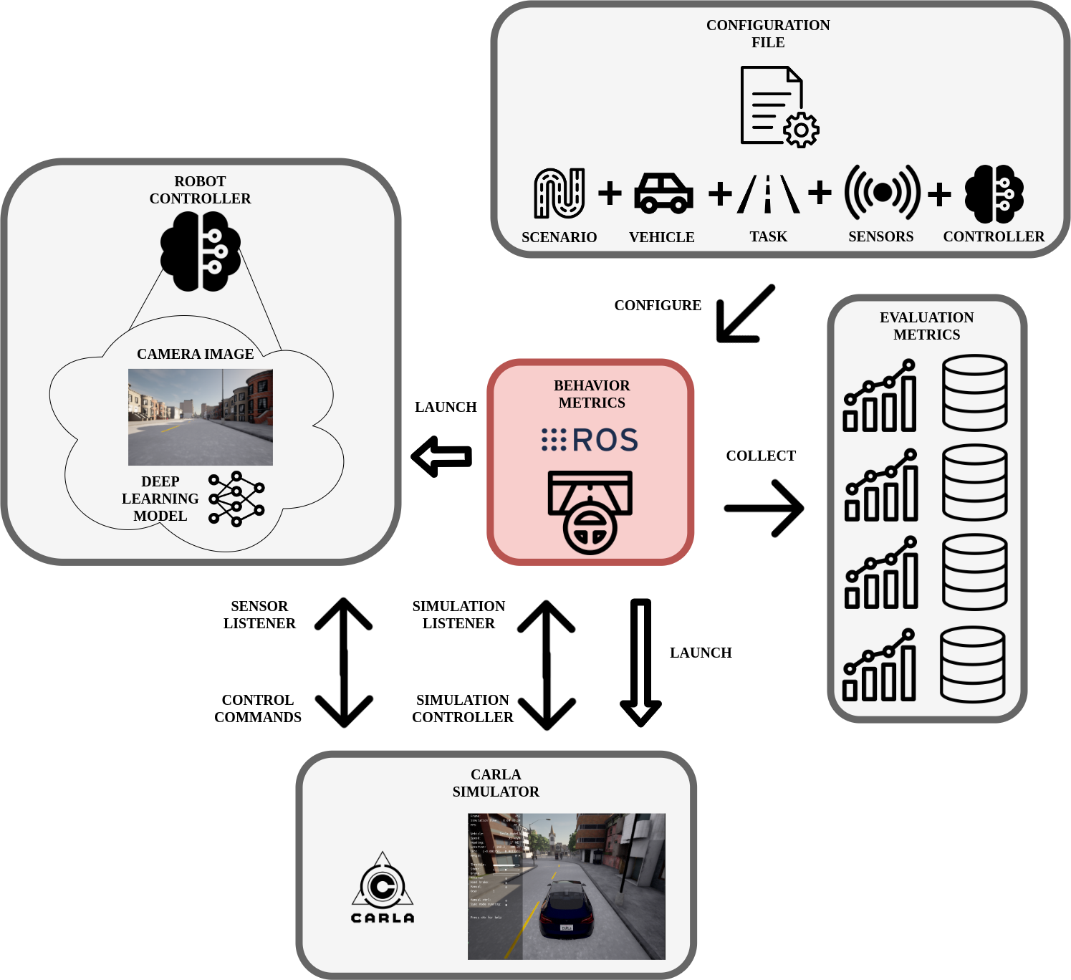
Assessing autonomous driving behaviors fine-grained metrics

Slide 35
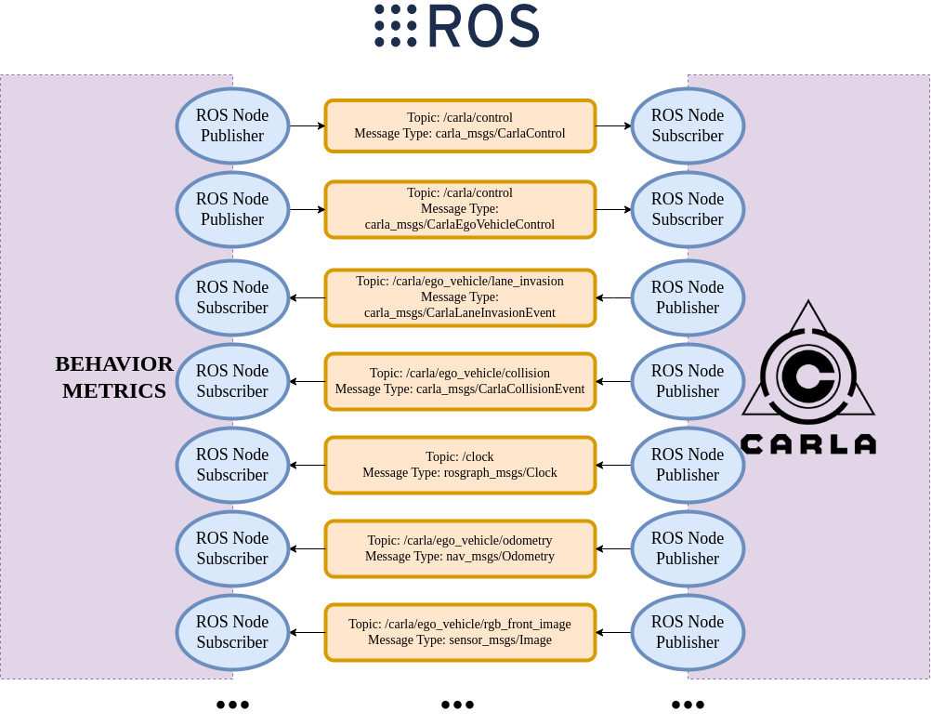
Connection between BM and CARLA

Slide 36
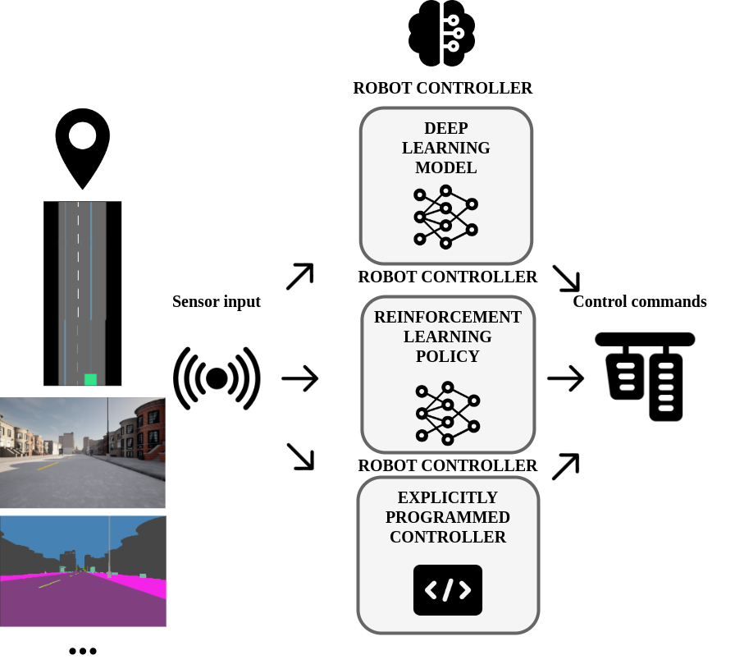
Robot controller

Slide 37
Supported tasks
It currently supports three main tasks:
Lane following.
Driving in traffic.
Point-to-point navigation.

Slide 38
Autonomous driving evaluation metrics
The proposed metrics are complementary to the simulator metrics (CARLA Leaderboard) and specific for each particular task:
Mean position deviation per km (MPD).
Effectively completed distance.
Vehicle longitudinal jerk per km.
Robot controller iteration frequency.
GPU inference frequency.
Collisions per km.
Lane invasions per km.
Distance to the front vehicle.
Route completion percentage.
Average speed.
Successful experiments.
…

Slide 39
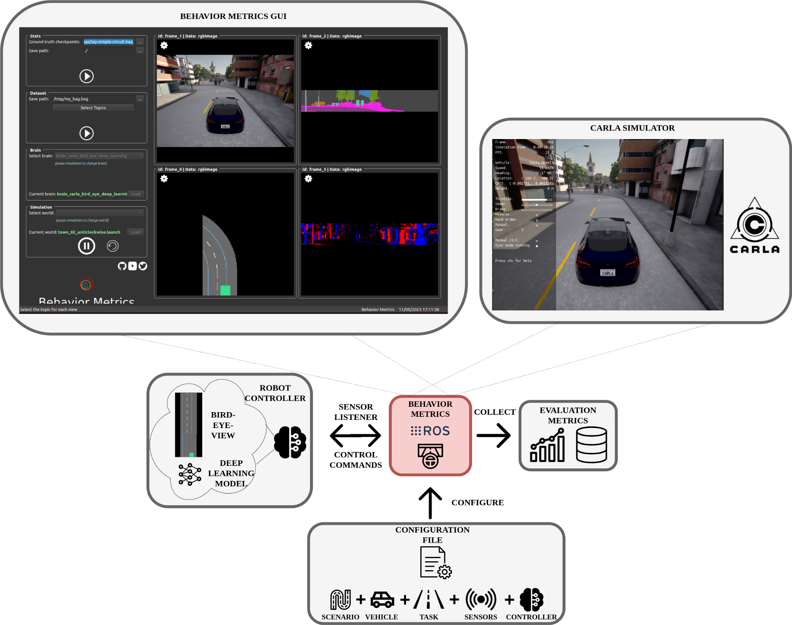
GUI evaluation mode

Slide 40
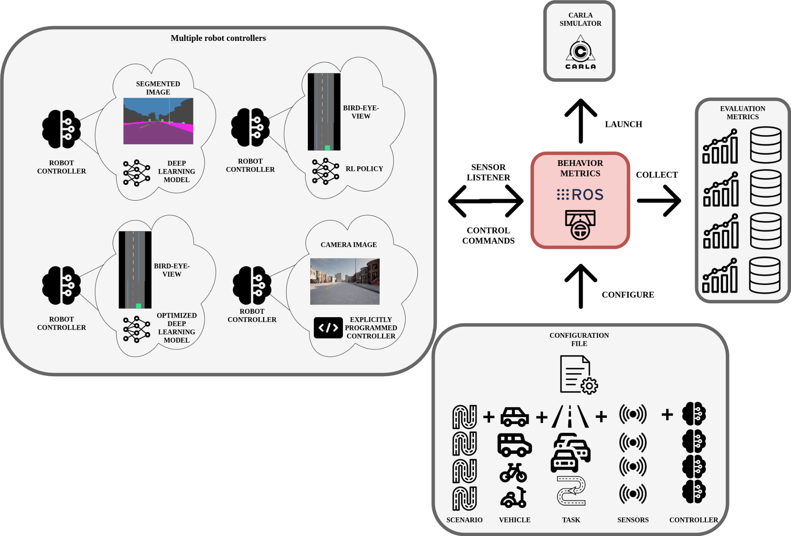
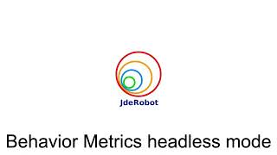
Headless evaluation mode

Slide 41
Impact and conclusions
Used as an assessment tool in this thesis.
Need for specialized assessment tool in AD for easy extraction of conclusions from experiments with fine-grained metrics.
Open-source.

Slide 42
Outline
Introduction
State-of-the-art
TrafficSensor
DetectionMetrics
Behavior Metrics
Adding memory
Optimizing DL models
Driving in traffic
Conclusions and future research
After tools development, solutions for imitation learning

Slide 43
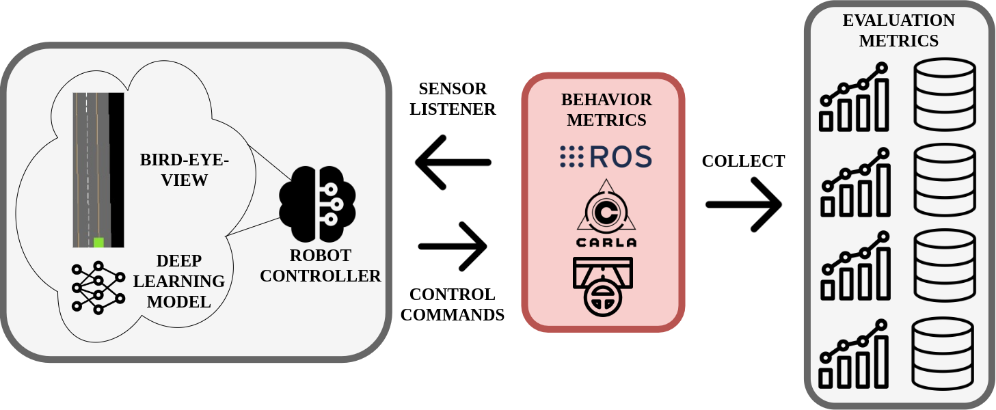
Enhancing E2E AD control through kinematic input and memory-based architectures
Baseline: imitation learning follow lane using PilotNet.
Explored and compared various approaches to enhance the capabilities of an E2E system for AD based on imitation learning adding visual memory and kinematic data input.
Offline and online evaluation (Behavior Metrics).
S. Paniego, R. Calvo-Palomino, and J. M. Cañas, “Enhancing End-to-End Control in Autonomous Driving through Kinematic-Infused and Visual Memory Imitation Learning,” Manuscript submitted for publication, 2024.

Slide 44
Enhancing E2E AD control through kinematic input and memory-based architectures
Lane-following application using different urban scenario layouts and visual bird-eye-view input.
Memory addition:
Architectural modifications.
Different types of sensory input.
Incorporating visual memory and kinematic input: more robustness and wider range of challenging situations (reduction of collisions and speed self-regulation).
LSTM, convLSTM…
Open source materials.

Slide 45
Kinematic-infused and visual memory E2E control based on imitation learning
8 DL models based on an E2E approach.
4 different DL architectures are explored:
One without memory.
Three with visual memory.
PilotNet (Bojarski et al. 2016).
Segmented bird-eye-view as input.
Expert agent data.

Slide 46
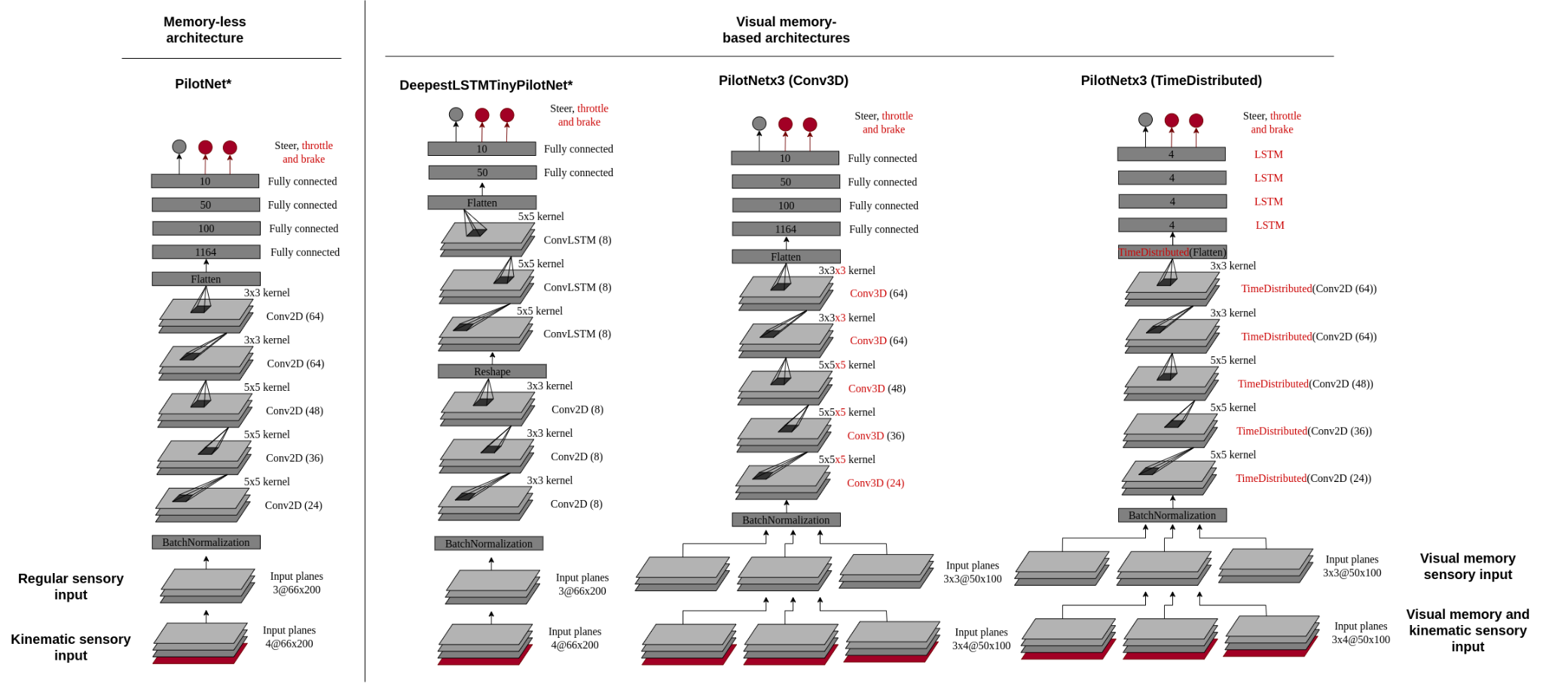
Kinematic-infused and visual memory E2E control based on imitation learning

Slide 47
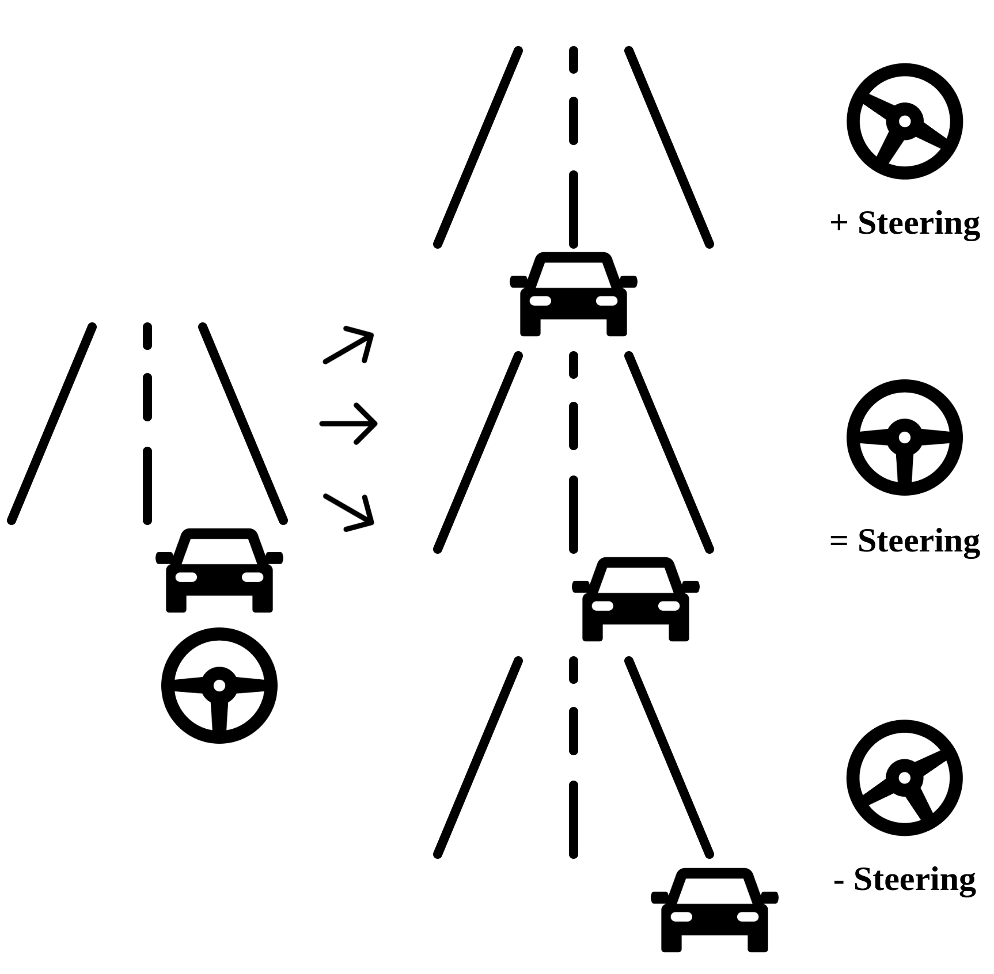
Kinematic-infused and visual memory E2E control based on imitation learning
Training:
20Hz for the collection.
Expert agent 30 km/h max.
Data augmentation. Affine.

Slide 48
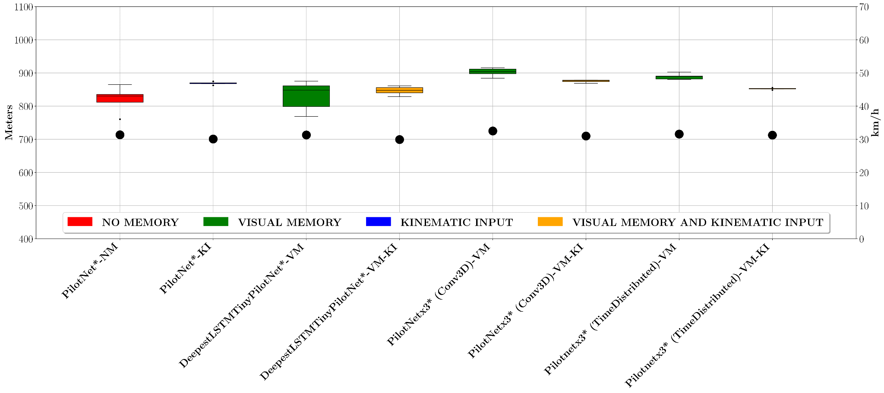
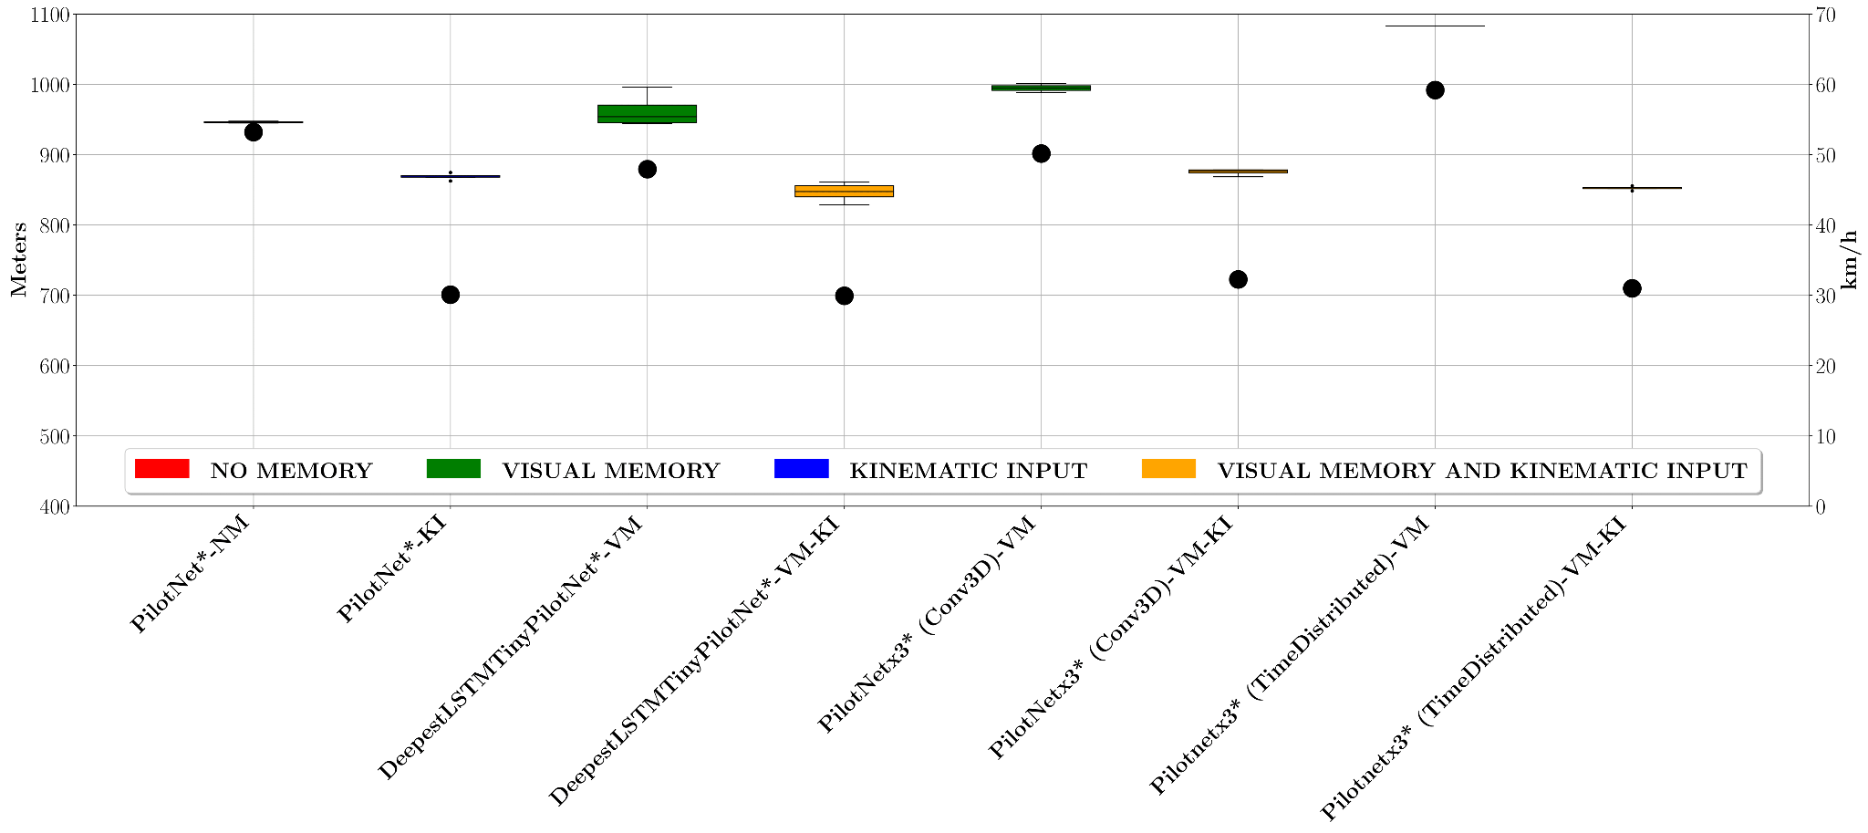
Top speed regulation vs no regulation

Slide 49
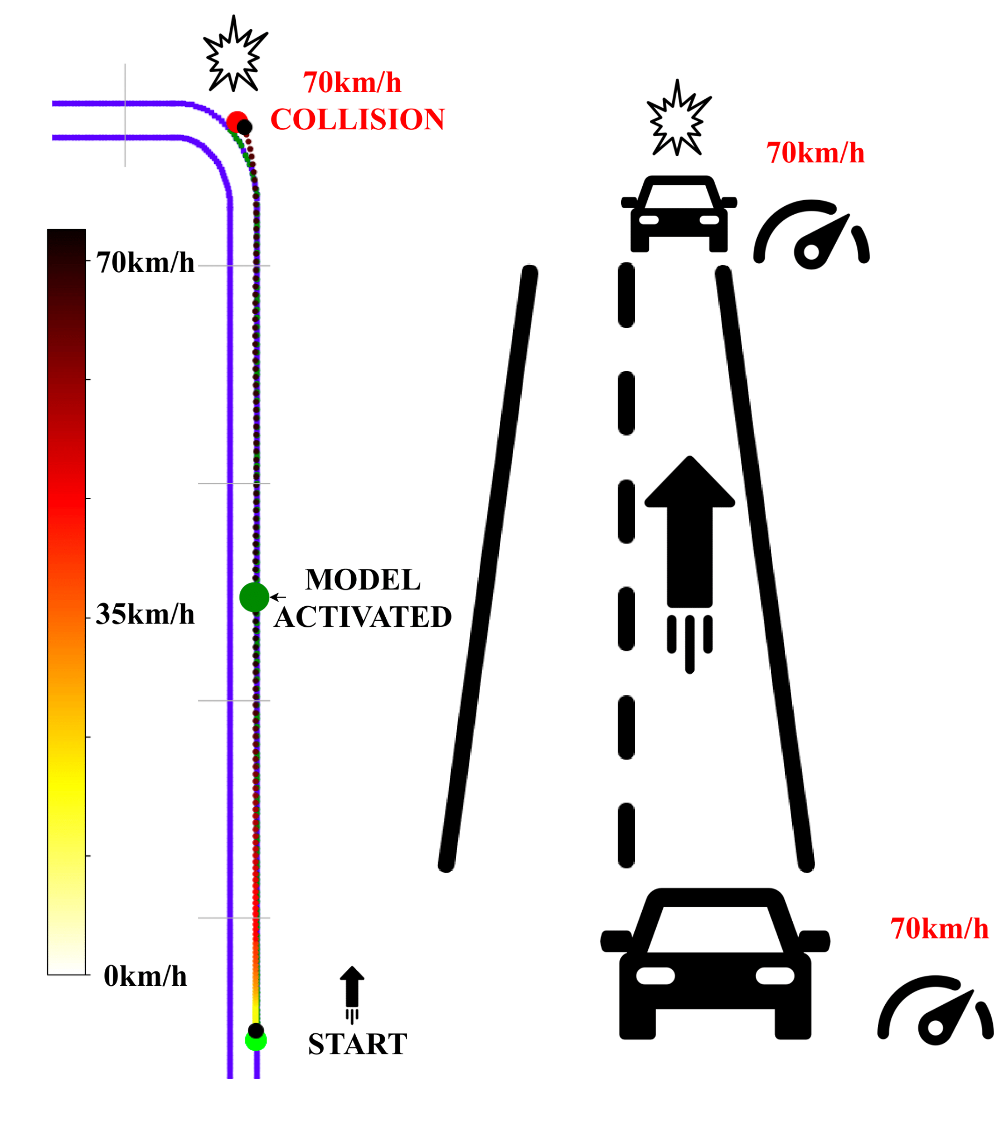
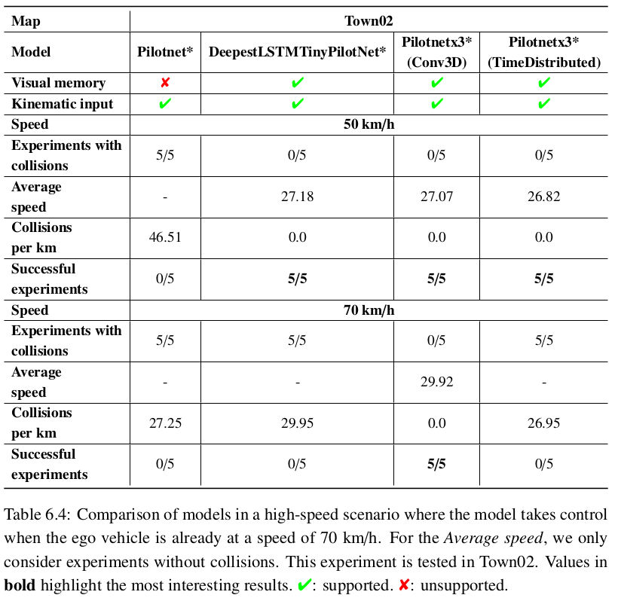
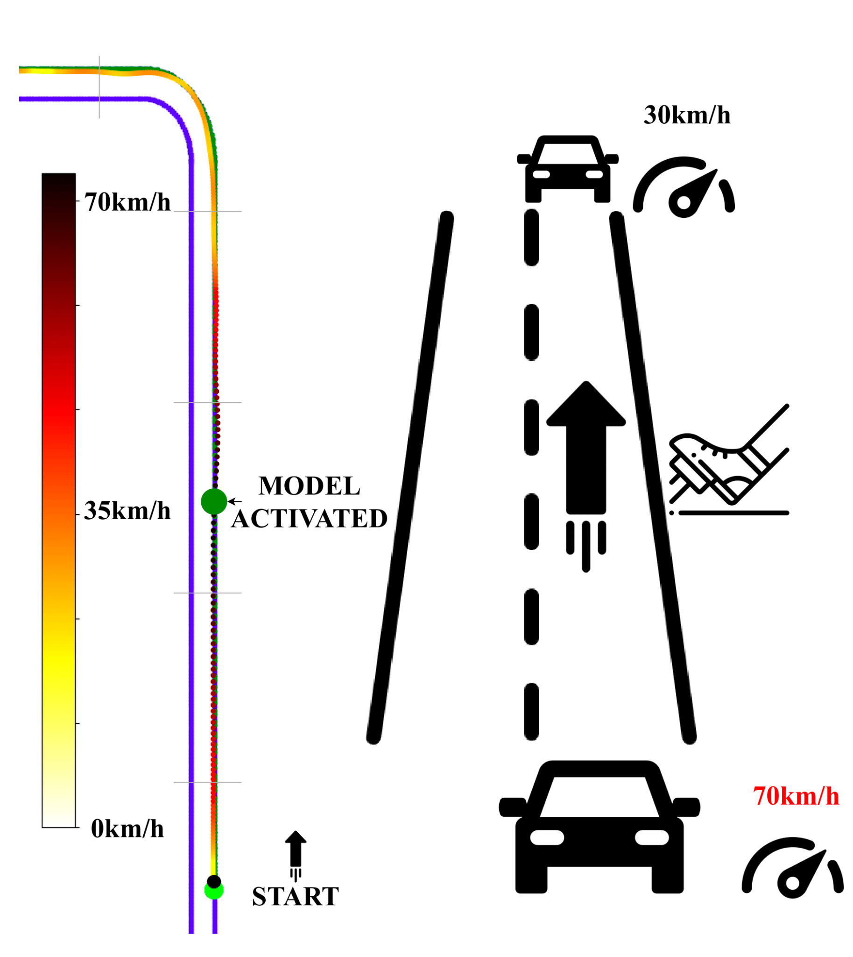
Taking control of a fast-moving car

Slide 50
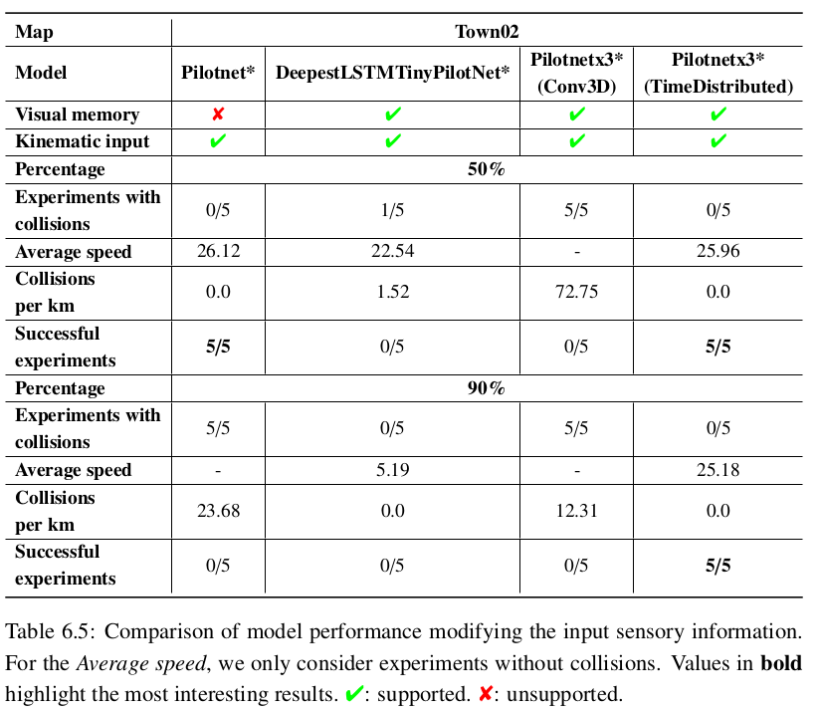
Robustness to sensory manipulation
50%
90%

Slide 51
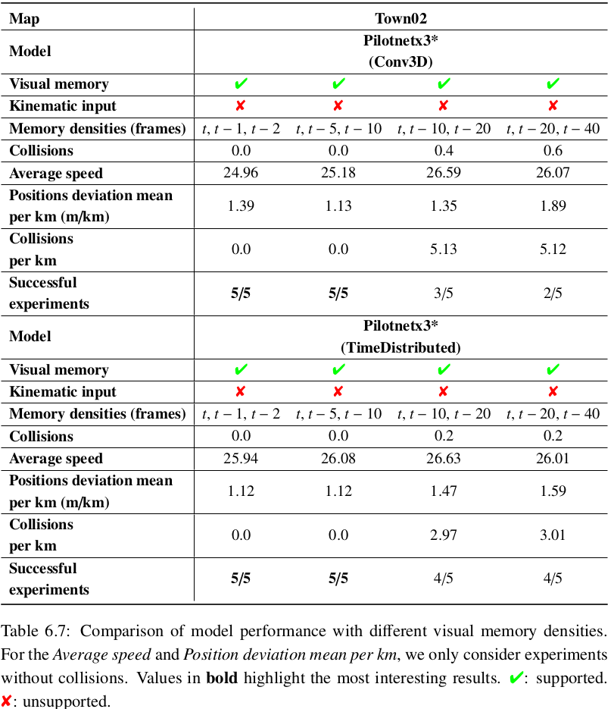
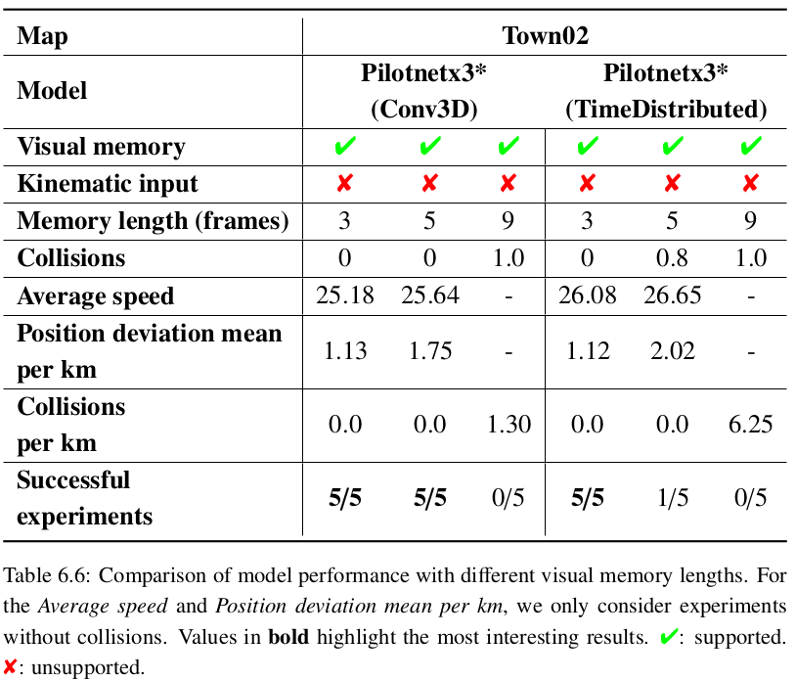
Visual memory length and density

Slide 52
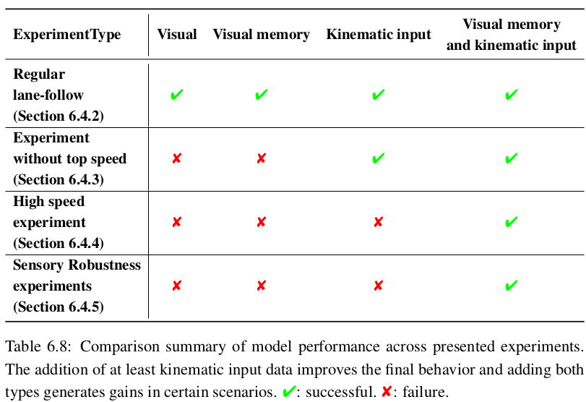
Conclusions
Adding visual memory and kinematic input to the models enhances the quality of the final control following the lane.
Adding kinematic data, the system controls the speed better.
Combining it with visual memory, the vehicle increases its range of application.

Slide 53
Outline
Introduction
State-of-the-art
TrafficSensor
DetectionMetrics
Behavior Metrics
Adding memory
Optimizing DL models
Driving in traffic
Conclusions and future research

Slide 54
Optimization of end-to-end autonomous driving control
We explore and compare a variety of alternatives for model optimization in the context of E2E imitation learning autonomous driving.
Performance depends on quality of decisions and their frequency. Increase frequency without sacrificing decision quality.
Run deep learning robot-control application even in limited computed hardware.
Open source materials.
S. Paniego, N. Paliwal, and J. Cañas, “Model optimization in deep learning based robot control for autonomous driving,” IEEE Robotics and Automation Letters and IEEE International Conference on Robotics and Automation (ICRA), vol. 9, no. 1, pp. 715–722, 2024. doi: 10.1109/LRA.2023.3336244. [Online]. Available: https://doi.org/10.1109/LRA.2023.3336244

Slide 55
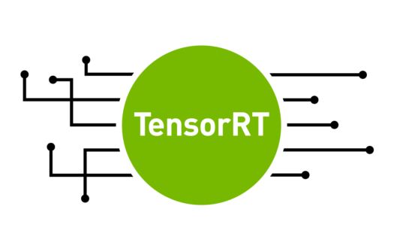
Optimization of end-to-end autonomous driving control
Trend towards E2E solutions.
DL models are high-demanding.
Available computing hardware is key for performance.
Some autonomous robots have high-performant hardware while others do not and is not always possible to upgrade (edge devices).
Optimization solution (framework support).

Slide 56
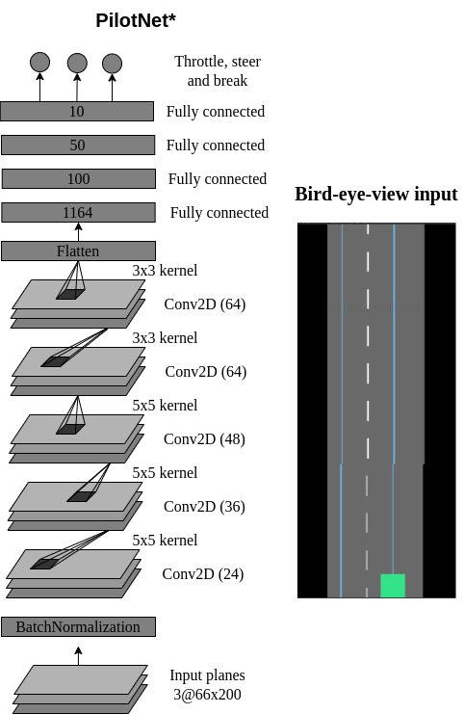
Optimizing E2E IL models for lane-follow robot control
The baseline architecture is based on PilotNet (Bojarski et al. 2016), named PilotNet*.

Slide 57
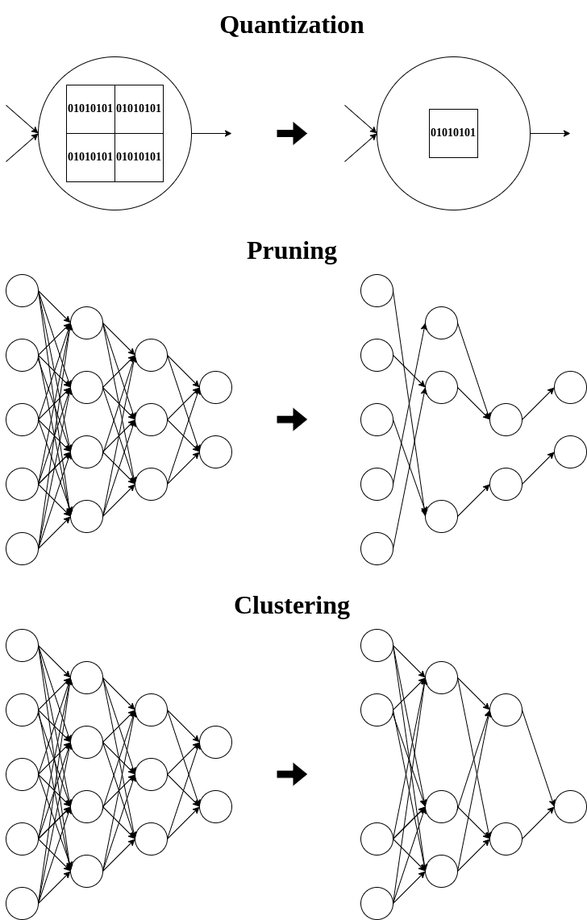
Optimizing E2E IL models for lane-follow robot control
Optimizations used:
Quantization (float16, int8).
Pruning.
Fine tuning (retraining).
Clustering.

Slide 58
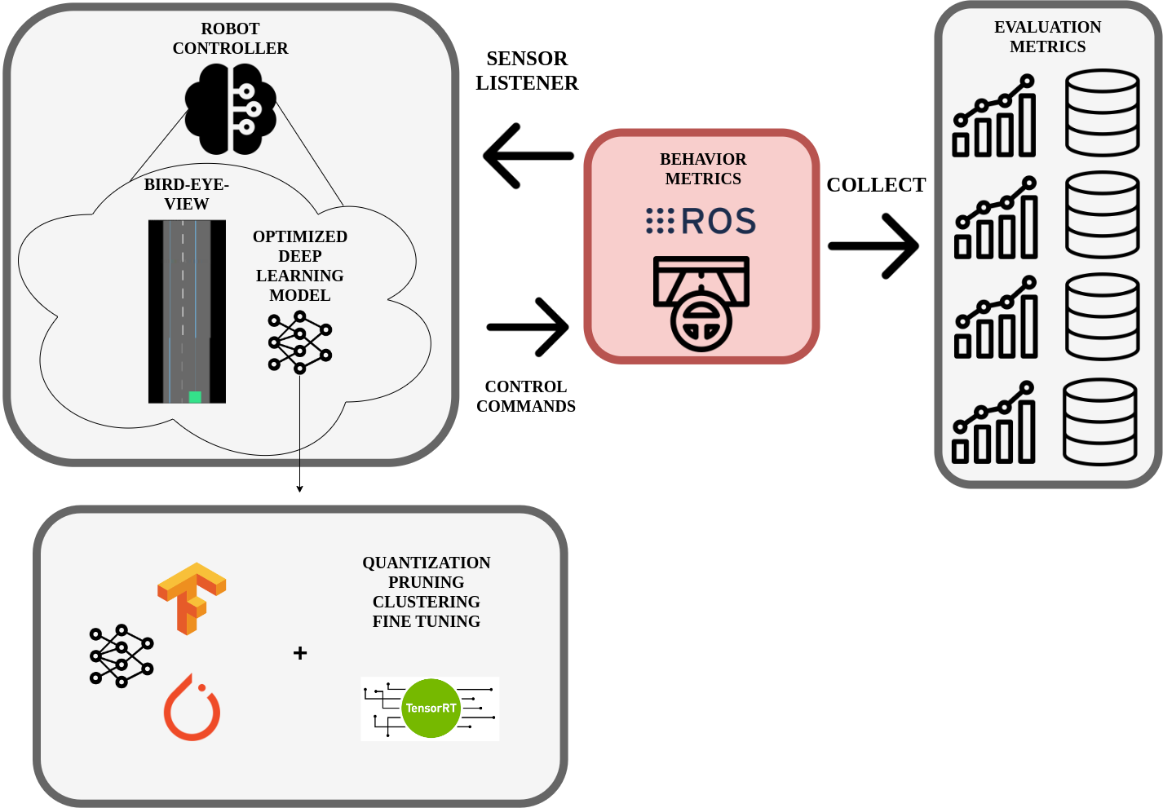
Assessment of Models
Behavior Metrics.
In addition to the simulator's metrics:
Controller frequency.
GPU inference frequency.
Position deviation mean per km.
Successful runs.

Slide 59
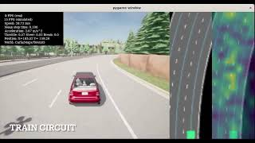
Experiment 1: Offline evaluation
Model size reduction (12x int8 quantization).
GPU inference frequency improves.
135x TensorRT int8 quantization.
50x framework-specific int8 quantization.
Similar MSE.
Combination of optimizations generates best case: PCQAT (Sparsity and cluster preserving quantization aware training).

Slide 60
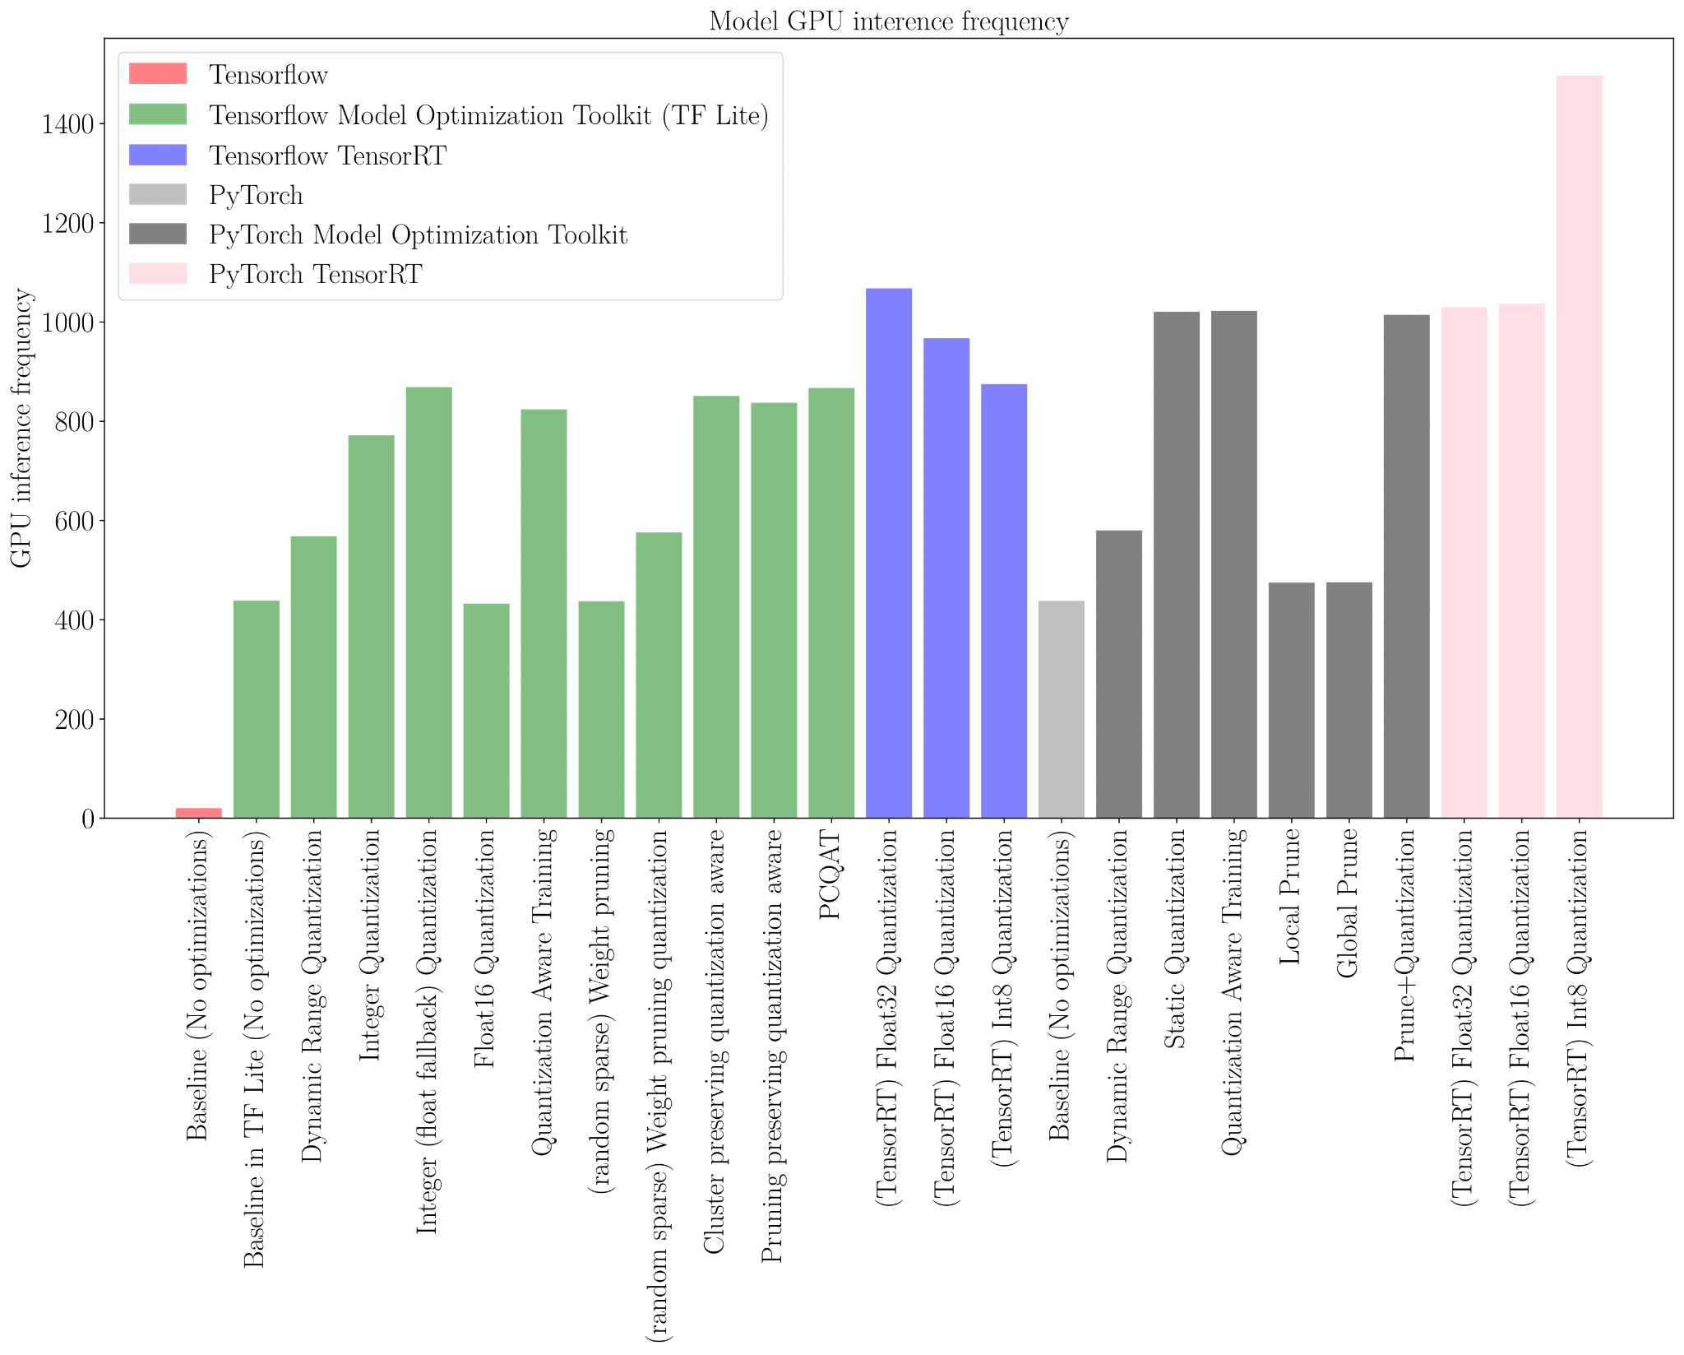
Experiment 2: Online evaluation
Higher controller frequency.
Faster models: int8 (47x TF, 2.3x PyTorch).
Similar mean position deviation and average speed.
Previous insights are applicable.
No decision quality degradation in online evaluation.
Faster and smaller models.
TF and PyTorch similar. TensorRT best.
Optimization limits require tuning.

Slide 61
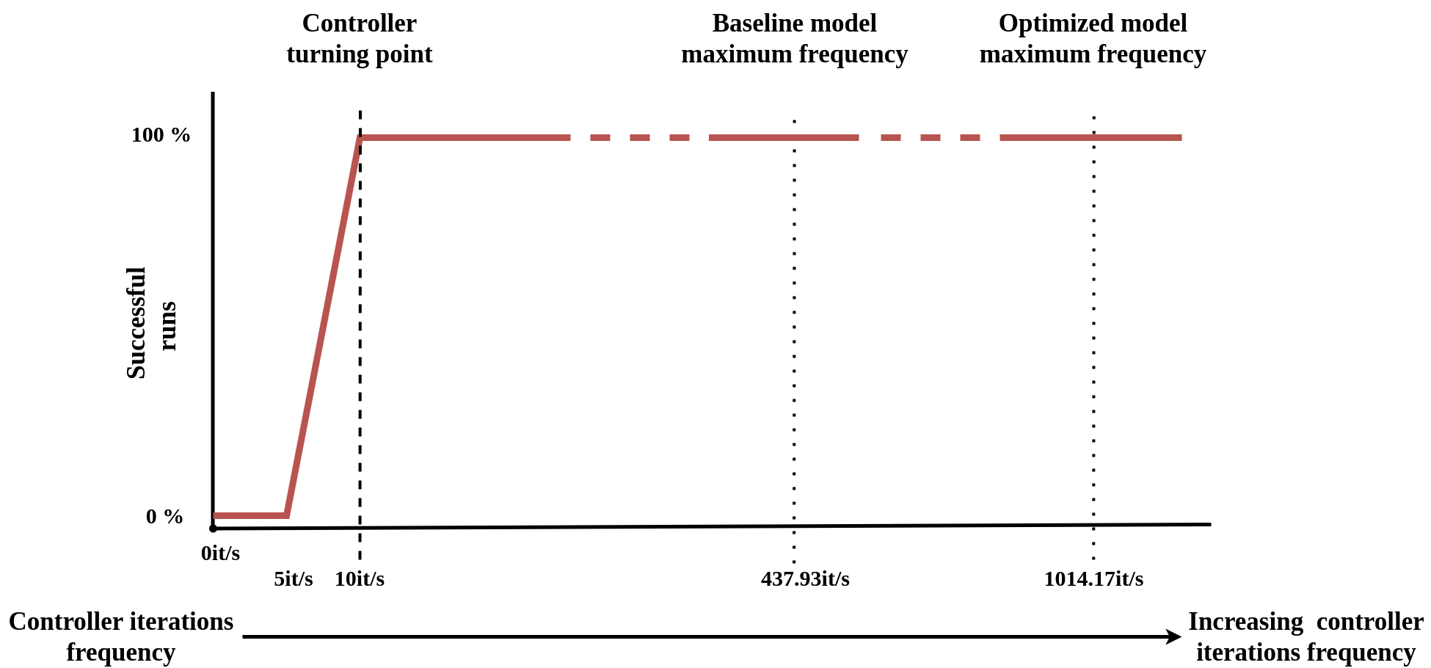
Experiment 3: Inference freq. and Quality of Decisions in Robot Control Performance
Quality changes when the frequency of decisions is changed in the robot control.
Optimizing benefits control quality since in limited hardware, it may be critical to generate decisions above the turning point.

Slide 62
Conclusions
Optimizations improve the system performance (controller speed-up without losing decision quality).
Offline and online evaluation.
Optimized models have wider range of application (edge devices).
Combination of optimizations and hardware-specific optimizations generate the best models.

Slide 63
Outline
Introduction
State-of-the-art
TrafficSensor
DetectionMetrics
Behavior Metrics
Adding memory
Optimizing DL models
Driving in traffic
Conclusions and future research

Slide 64
End-to-end vision-based autonomous driving in traffic
A shallow E2E vision-based DL approach for autonomous driving in traffic scenarios.
Goals: follow the lane and maintain a safe distance from possible preceding vehicles.
We prioritize simplicity of the model.
Subjective visual input.
S. Paniego, E. Sinohara, and J. M. Cañas, “Autonomous Driving in Traffic with End-to-End Vision-based Deep Learning,” Neurocomputing, 2024. doi: 10.1016/j.neucom.2024.127874. [Online]. Available: https://www.sciencedirect.com/science/article/pii/S0925231224006453

Slide 65
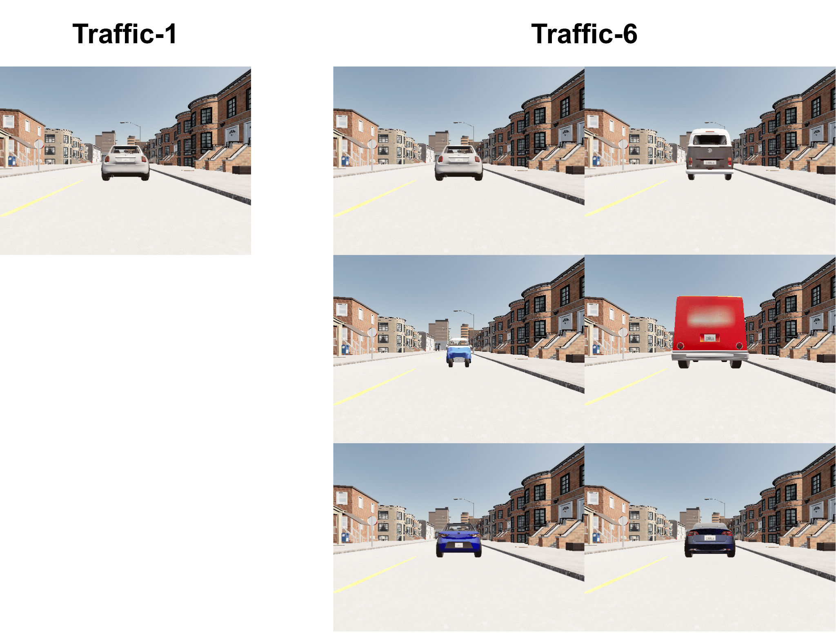
Imitation learning for driving in traffic
Dataset extracted from expert agent behavior.
Traffic-0: does not consider traffic.
Traffic-1: includes one type of front vehicle.
Traffic-6: includes 5 other vehicles including vans and three urban cars of different sizes and colors.

Slide 66
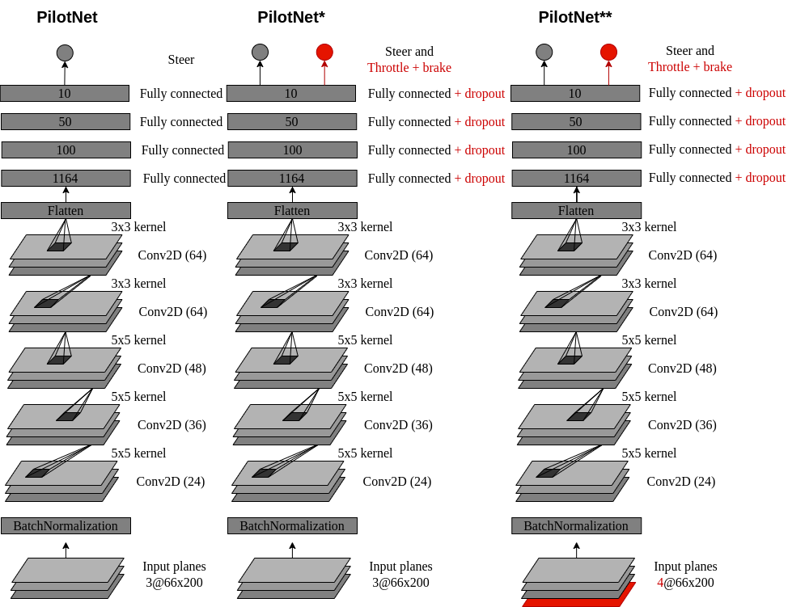
Imitation learning for driving in traffic
2 models are variations of PilotNet (PilotNet* and PilotNet**).
We include oversampling during training.

Slide 67
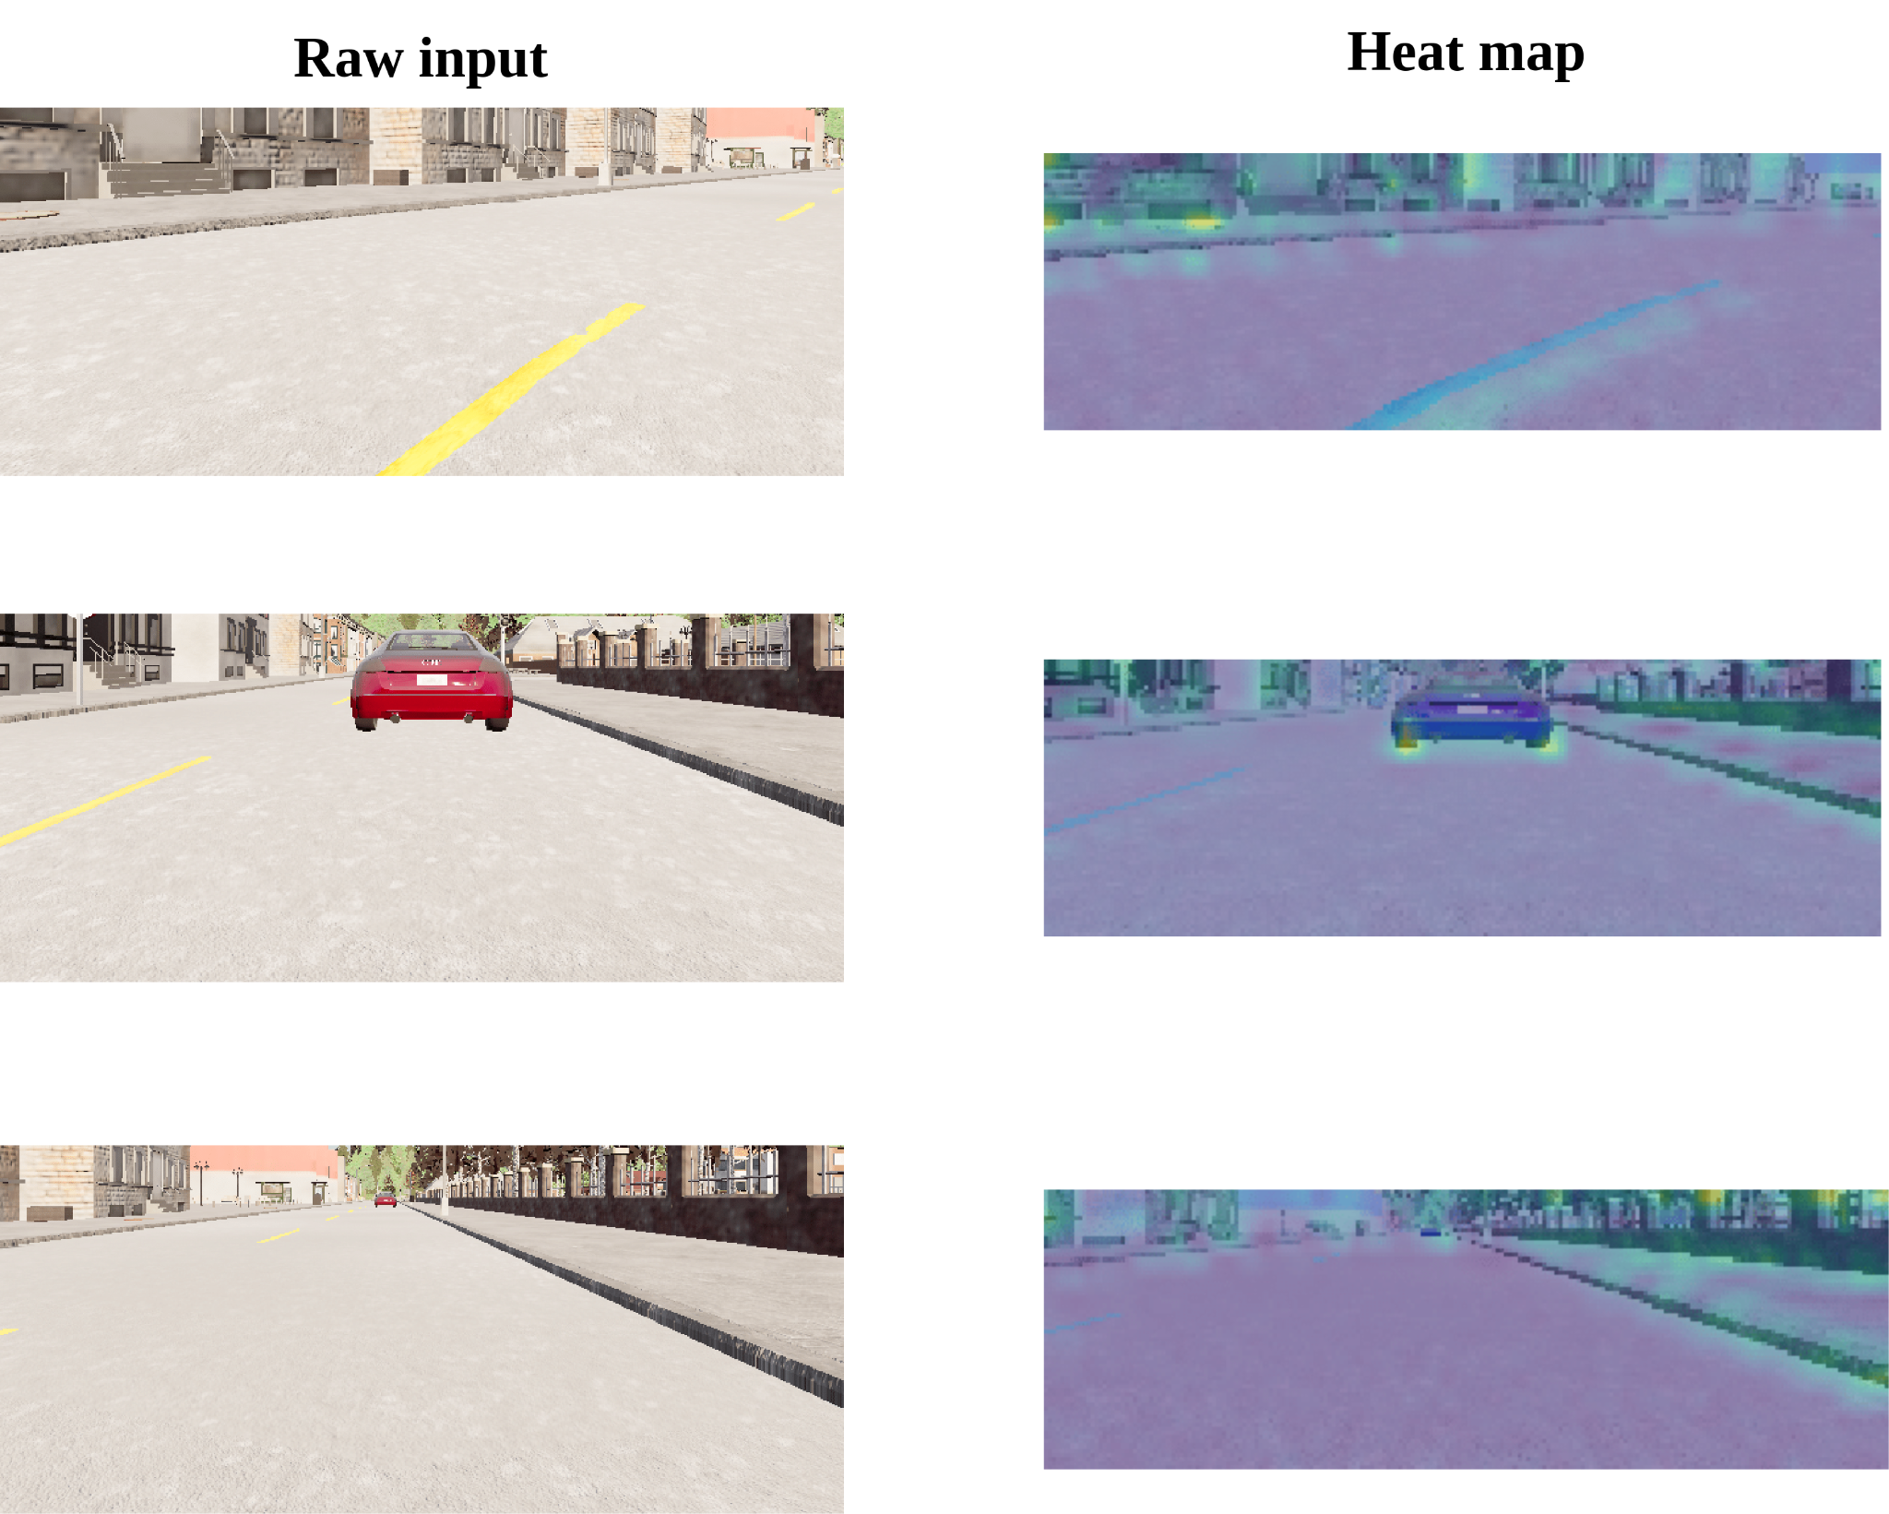
End-to-end vision-based autonomous driving in traffic
We utilize activation heatmaps to understand where the models is paying attention during the decision making (Grad-CAM).

Slide 68
Experimental setup
We use Behavior Metrics for the online evaluation, including new specialized metrics (distance to vehicle).
With small changes to the architecture of PilotNet, it is possible to expand its functionality.

Slide 69
Experiment 1: Execution without traffic
All the combinations of model+dataset works correctly. The model trained with Traffic-6 is better in MPD and Lane invasions.

Slide 70
Experiment 2: Execution with traffic
The model trained with Traffic-6 is better for all the metrics.

Slide 71
Experiment 3: generalization
The model trained with Traffic-6 generalizes for a whole set of vehicles never-seen during training.

Slide 72
End-to-end vision-based autonomous driving in traffic

Slide 73
Conclusions
Proposal for safe autonomous driving in traffic scenarios following and E2E vision-based approach with imitation learning and deep learning.
The shallow models slightly changed can drive in traffic situations successfully as proved experimentally.
We also include a new metrics to Behavior Metrics.
TFM co-direction.

Slide 74
Outline
Introduction
State-of-the-art
TrafficSensor
DetectionMetrics
Behavior Metrics
Adding memory
Optimizing DL models
Driving in traffic
Conclusions and future research

Slide 75
Conclusions and future research
Make contributions in the field of vision-based autonomous driving using deep learning, imitation learning and end-to-end models.
Deep learning-based visual traffic monitoring tool.
Generate software for validating object detection solutions.
Create software to assess autonomous driving behaviors and generate quantitative data.
Study of enhancements to visual lane following using visual memory and kinematic input.
Optimizing AD vehicle controllers to enhance performance.
Create and E2E shallow model for driving in traffic using vision.

Slide 76
Research contributions
5 journal and conference papers:
S. Paniego, R. Calvo-Palomino, and J. Cañas, "Behavior Metrics: An Open-Source Assessment Tool for Autonomous Driving Tasks," Software X, vol. 26, pp. 101702, 2024 doi: 10.1016/j.softx.2024.101702. [Online]. Available: https://doi.org/10.1016/j.softx.2024.101702 [239]
S. Paniego, N. Paliwal, and J. Cañas, “Model optimization in deep learning based robot control for autonomous driving,” IEEE Robotics and Automation Letters and IEEE International Conference on Robotics and Automation (ICRA), vol. 9, no. 1, pp. 715–722, 2024. doi: 10.1109/LRA.2023.3336244. [Online]. Available: https://doi.org/10.1109/LRA.2023.3336244 [244]
S. Paniego, V. Sharma, and J. M. Cañas, “Open source assessment of deep learning visual object detection,” Sensors, vol. 22, no. 12, 2022. doi: 10.3390/s22124575. [Online]. Available: https://www.mdpi.com/1424-8220/22/12/4575 [234]
J. Fernández, J. M. Cañas, V. Fernández, and S. Paniego, “Robust real-time traffic surveillance with deep learning,” Computational Intelligence and Neuroscience, vol. 2021, p. 4 632 353, Dec. 2021. doi: 10.1155/2021/4632353. [Online]. Available: https://doi.org/10.1155/2021/4632353 [224]
S. Paniego, E. Sinohara, and J. M. Cañas, “Autonomous Driving in Traffic with End-to-End Vision-based Deep Learning,” Neurocomputing, 2024. doi: 10.1016/j.neucom.2024.127874. [Online]. Available: https://www.sciencedirect.com/science/article/pii/S0925231224006453

Slide 77
Research contributions
1 manuscript under peer-review:
Sergio Paniego, Roberto Calvo-Palomino, and José María Cañas, “Enhancing End-to-End Control in Autonomous Driving through Kinematic-Infused and Visual Memory Imitation Learning”.
1 preprint:
S. P. Blanco, S. Mahna, U. A. Mishra, and J. Canas, Memory based neural networks for end-to-end autonomous driving, 2022. arXiv: 2205.12124 [cs.RO]. [256]
1 workshop paper:
P. F. de Cabo, R. Lucas, I. Arranz, S. Paniego, and J. M. Cañas, “RL-studio: A tool for reinforcement learning methods in robotics,” in ROBOT2022: Fifth Iberian Robotics Conference, Springer International Publishing, Nov. 2022, pp. 502–513.doi: 10.1007/978-3-031-21062-4_41. [Online]. Available: https:// doi.org/10.1007%2F978-3-031-21062-4_41. [257]

Slide 78
Future (current) work 1
Point-to-point E2E navigation using input commands.
GSoC project.

Slide 79
Future (current) work 2
Transferring current E2E solutions to a real-world vehicle.

Slide 80
Future (current) work 3
E2E autonomous driving modulated with text-based instructions (LLMs).
GSoC project.

Slide 81
Future (current) work 4, 5, 6
Exploration of E2E autonomous driving in unstructured environments.
TFM co-direction.
Exploration of E2E autonomous driving in aerial vehicles.
Combination of driving experts.
TFG co-direction.

Slide 82
Materials

Slide 83
End-to-end Vision-based Autonomous Driving using Deep Learning
Author
Sergio Paniego Blanco
Supervisor
José María Cañas Plaza
Doctoral Program in Information and Communications Technologies
International Doctoral School
2024
@sergiopaniego
sergio.paniego@urjc.es
https://sergiopaniego.github.io/

Slide 85
E2E vs modular
“End-to-end Autonomous Driving: Challenges and Frontiers”
Advantages:
Simplicity in combining perception, prediction, and planning into a single model.
The whole system is optimized towards the ultimate task of planning/control.
More computationally efficient.
Data-driven optimization has the potential to improve the system by simply scaling training resources.
Limitations/Challenges:
Handling different input modalities.
Visual abstraction.
World model learning.
Multi-task frameworks.
Inefficient experts and Policy distillation.
Lack of interpretability.
Causal confusion.
Lack of Robustness.
…

Slide 86
Transferring to real world
Domain adaptation.
Increase sensor coverage.
Incorporate real-world data into training.

Slide 87
End-to-end Vision-based Autonomous Driving using Deep Learning
Author
Sergio Paniego Blanco
Supervisor
José María Cañas Plaza
Doctoral Program in Information and Communications Technologies
International Doctoral School
2024
@sergiopaniego
sergio.paniego@urjc.es
https://sergiopaniego.github.io/

